Slide 1
Data Marketing Solutions Overview

Slide 2

WHO WE ARE
The Data Marketing Solutions (DMS) team is comprised of those that field pre-sales questions, counts, estimates, and provide product consultation, as well as those that execute on the campaigns themselves.
In addition, we partner with the IIRIS team for email deployment.
TONI CUMBERBATCH
Sr. Director
AMY MILLER
Director
SHERRY GRIDDINE
Programmatic & Social Media Manager
BETHANY GERSON
Manager
SHERRY GRIDDENS
Programmatic & Social Media Manager
JUSTIN LYMAN
Manager
MICHAEL WROBEL
Manager
ANTHONY TREGLIA
Sr. Manager
DALE COLLINGE
Audience Extension Operations Manager

Slide 3
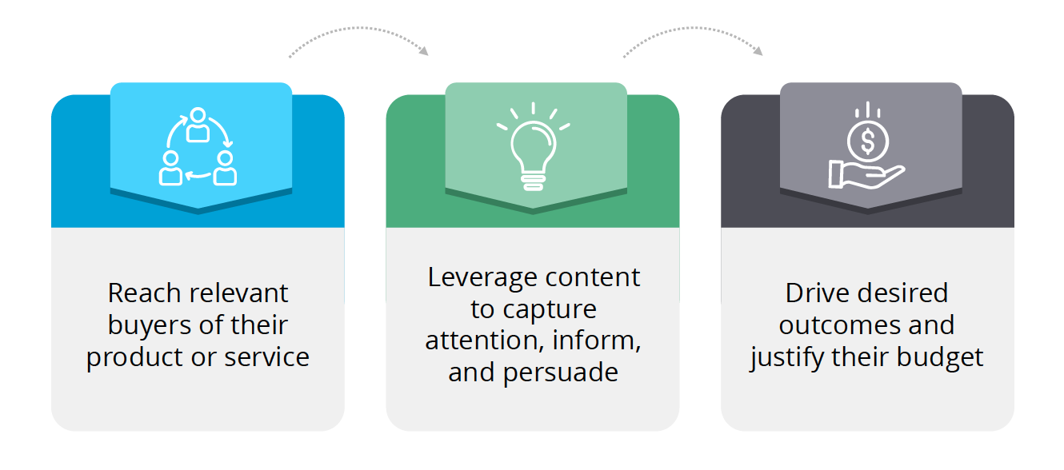
WHAT WE DO
Our team empowers advertisers by delivering data-driven marketing campaigns powered by their creative material. We aim to meet customer and marketers' objectives by driving effective results. By utilizing our permissioned, first-party data, we’ve delivered over 2,300 campaigns in 2022, equal to over 6M in revenue.

Slide 4
HOW WE DO IT
PRE-SALES CONSULTATION
QUOTE/RFP
ORDER
PM
EXECUTE
REPORTING
The DMS team plays a vital role throughout the life of a campaign, beginning with the pre-sales process and continuing to final reporting.
Critical Steps for Success:
Accurate scoping
Realistic quoting
Feasible execution timeline

Slide 5
DMS PRODUCTS
Our strategic audience-based marketing solutions utilize 1st party data combined with smart targeting to generate awareness, drive audience engagement, and qualify prospects.
AUDIENCE / EVENT EXTENSION
EMAIL
PROGRAMS
LIST
RENTAL
  Across the web
  Social media: Facebook, Instagram, LinkedIn
  Video: Instream, CTV
  Account-Based Marketing (ABM)
  Multi-touch
  Multi-variate tests
  Email series
  Account targeting
  Postal
  Phone

Slide 7
It's all about the data!

Slide 8

FIRST-PARTY DATA
We ONLY use proprietary first-party data (owned information collected directly from customers) that has been permissioned via opt-in. We do not use 2nd or 3rd party data.
Advantages of First-Party Data:
Builds direct relationships with audience
Ensures compliance (GDPR)
Improves data integrity
Creates a single customer view
Personalizes customer experience
Delivers business value in a mostly cookieless world

Slide 9

GDPR & DATA COMPLIANCE
Permissioned data under General Data Protection Regulation (GDPR) regulations requires businesses to obtain explicit consent from individuals before collecting and processing their personal data, and to provide clear and concise information about how that data will be used.
Informa and the Data Marketing Solutions team ensures that websites where ads appear are GDPR compliant and any data processed maintains the required legal framework.
We do our due diligence with data collection and storage, so you can give your clients peace of mind.

Slide 10

DATA SOURCES
Informa attendees, subscribers, readers, and visitors are asked whether they wish to receive marketing from our partners. Once confirmed, those audiences are considered PERMISSIONED for Partner use.
Self-Reported Client Data
Eloqua
Infront
Omeda
AIG/WebOtis
Adestra
IIRIS Segment

Slide 11



UNPARALLELED DATA INTELLIGENCE
Informa’s exclusive first-party data sources build reliable event audience segments to enhance targeting with accuracy and scale, eliminating media waste to reach the right people at the right time.
Current Attendees
Past Attendees
Firmographic
Information
Demographic
Information
Geographic
Information
Content Consumption
Website Behavior

Slide 12
DATA FUELS CAMPAIGNS
We use the available first-party data to fuel advertiser campaigns and drive results.
Advertiser Campaign Platforms:
AIG
Amobee
AdDaptive
Facebook
LinkedIn
DATA SOURCE
ADVERTISER CAMPAIGNS
RESULTS

Slide 13
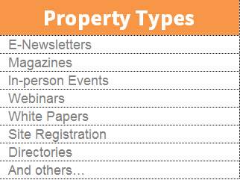

HOW WE RECEIVE DATA
Informa engages and informs millions of professionals across the globe every day regarding business-critical topics across multiple communication channels.
Informa’s customers provide necessary information when they complete forms providing self-reported or “first-party” data. This data is added to Informa’s source systems for each property to be accessed by in-market marketers, campaign marketers and data marketing managers based on geographical compliance and the individual’s permissions.
DMS and our Data Team aggregate and access the partner permissioned data from our database or directly from the source system for Custom, Targeted, Data-Fueled Marketing Programs.

Slide 14
PROGRAMS THAT MONETIZE DATA

Slide 15
EMAIL

Slide 16

EMAIL MARKETING IS STILL EFFECTIVE
Did you know?
According to the Revenue Marketing Alliance, 99% of email users check their inbox daily, some as often as 20 times a day! If you’re not optimizing your B2B email marketing strategy, you’re missing out on a crucial channel of communication with your audience.

Slide 17


WHAT DO ADVERTISERS SAY?
According to HubSpot, “email marketing is 40 times more effective than Facebook and Twitter when it comes to customer acquisition, thanks to its versatility and targeting capability”.
Email marketing campaigns are still a highly effective marketing tool that can help achieve your most critical business objectives and goals by:
Generating click-throughs
Driving audience engagement
Qualifying prospects

Slide 18
DRIVING RESULTS
Targeting
DMS offers a high-level of targeting capability enabling partners/advertisers to slice and dice the data by specific demographics across your brand, including:
Titles
Functions
Industries
Purchasing Authority
Geographic areas
Content consumption, i.e., eNewsletters
Brand-specific demos
Email Capabilities to Drive Results:
Subject line testing and roll-outs to the Winner
Creative Testing
Multivariate Tests
Multi-touch
Useful for:
Driving traffic to landing pages and websites
Generating audience engagement
Promoting assets such as Whitepapers, ebooks, live events and Webinars
Announcing product launches/press releases
Marketing products and services
And more!

Slide 19
AUDIENCE EXTENSION

Slide 20
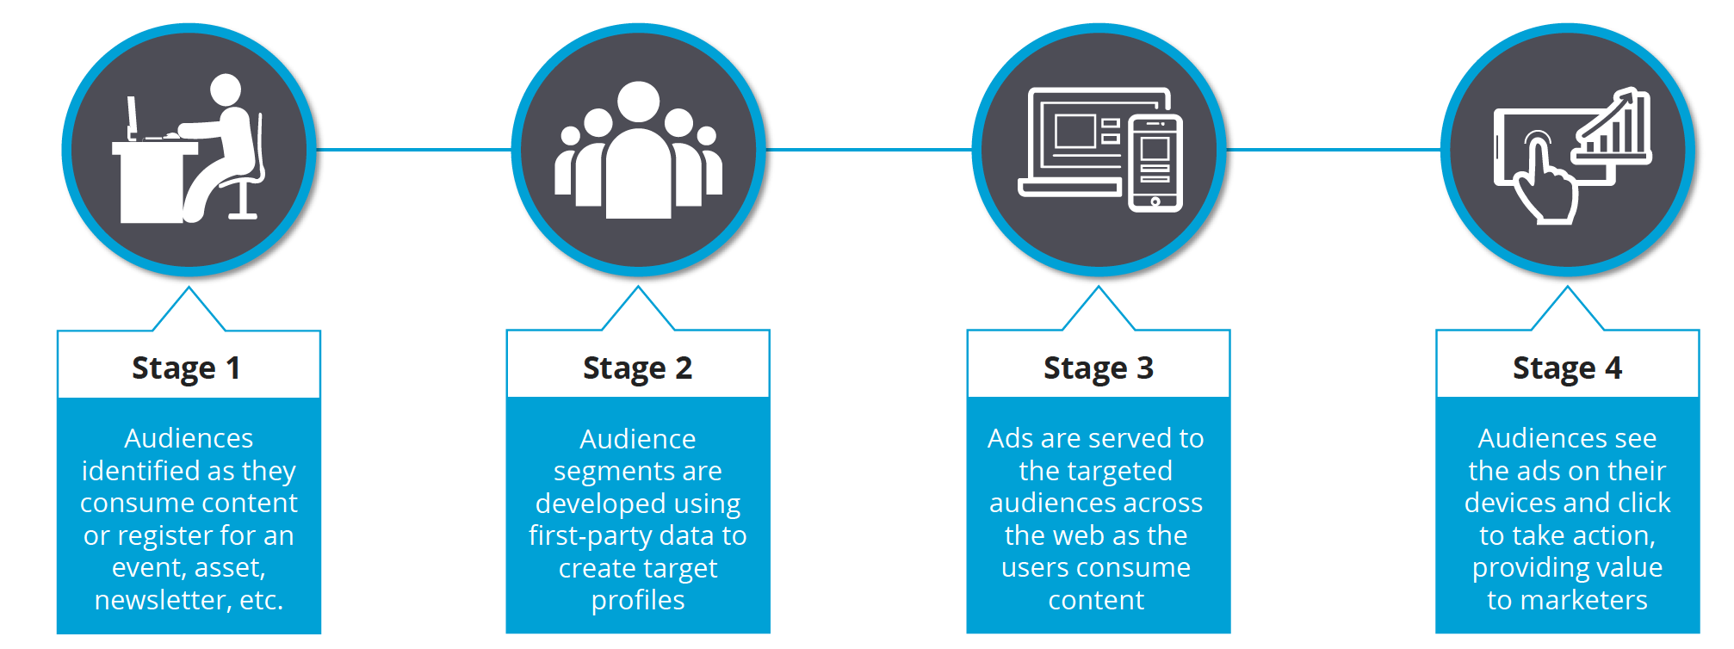
AUDIENCE EXTENSION EXPLAINED
Audience Extension campaigns target ideal prospects by utilizing our first-party database, collected through registrations, subscribing to newsletters, etc. Through consultation, we match the audience criteria to our database. The audience data then fuels the ad campaign to reach the target audience via ads across brand-safe websites and social media.

Slide 21
TARGETING OPTIONS
1
2
Turnkey/pre-packaged Segments
Account-Based Marketing (ABM)
Geo-Fencing
Custom Segments
Demographic or pixel-based
Based on demos and geo from database)
3
4
U.S. only
OR ANY COMBINATION OF THE ABOVE

Slide 22
TARGETING METHODS
Database Segments
Demographics and brand specific data points, such as titles, functions, and geography
eNewsletter recipients
Pixel-based Segments
Site visitors to your website
Geo-fencing
Within the radius of a physical location
Limited to display advertising only
Account-based Marketing (ABM)
Based on client’s key account list – uses data from both the Informa database and 3rd party data (U.S. only)
Client’s account lists that are matched to our database
Can be comprised of activity across the whole site or specific topical areas.

Slide 23
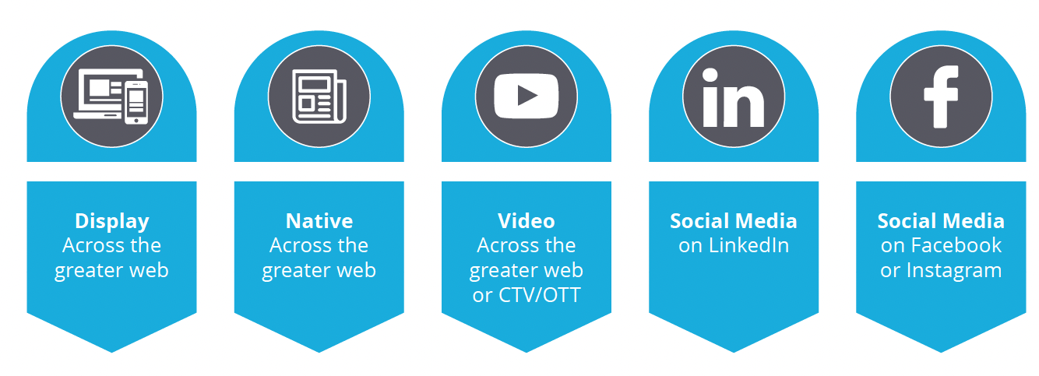
CHANNELS & AUDIENCE EXTENSION TYPES
Audience Extension has the flexibility to utilize any of the combinations below.

Slide 24
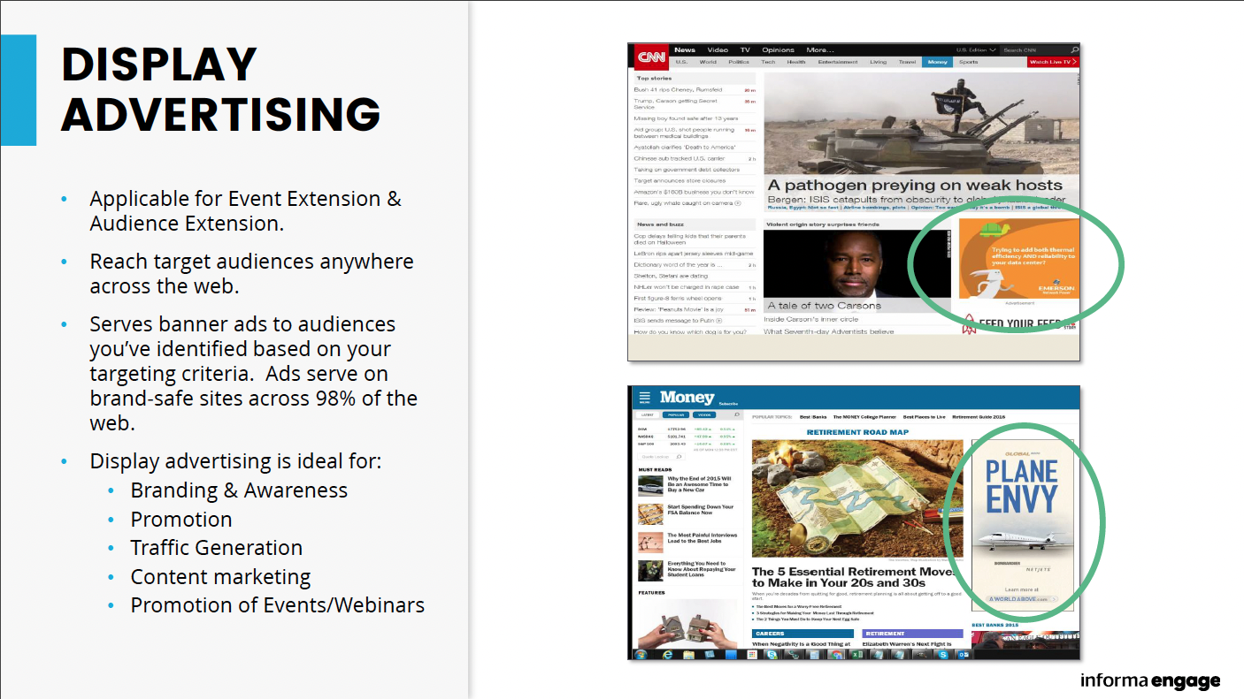

Slide 25
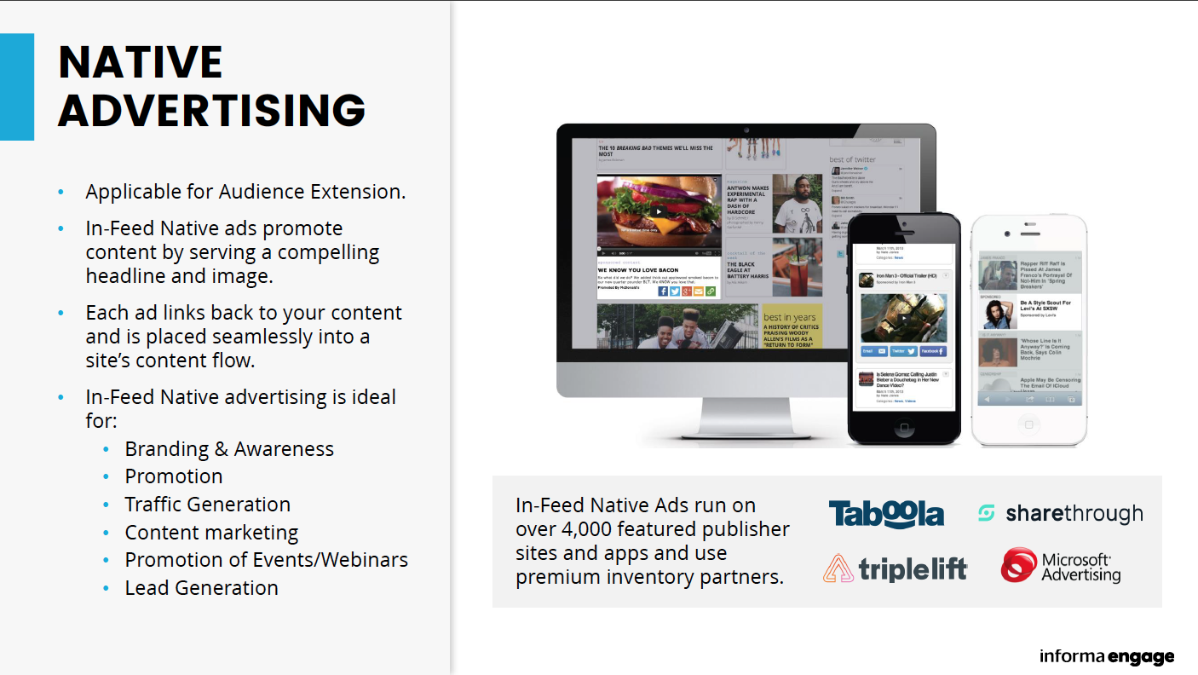

Slide 26
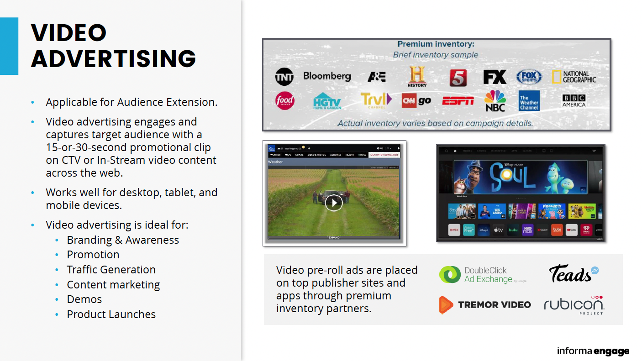

Slide 27
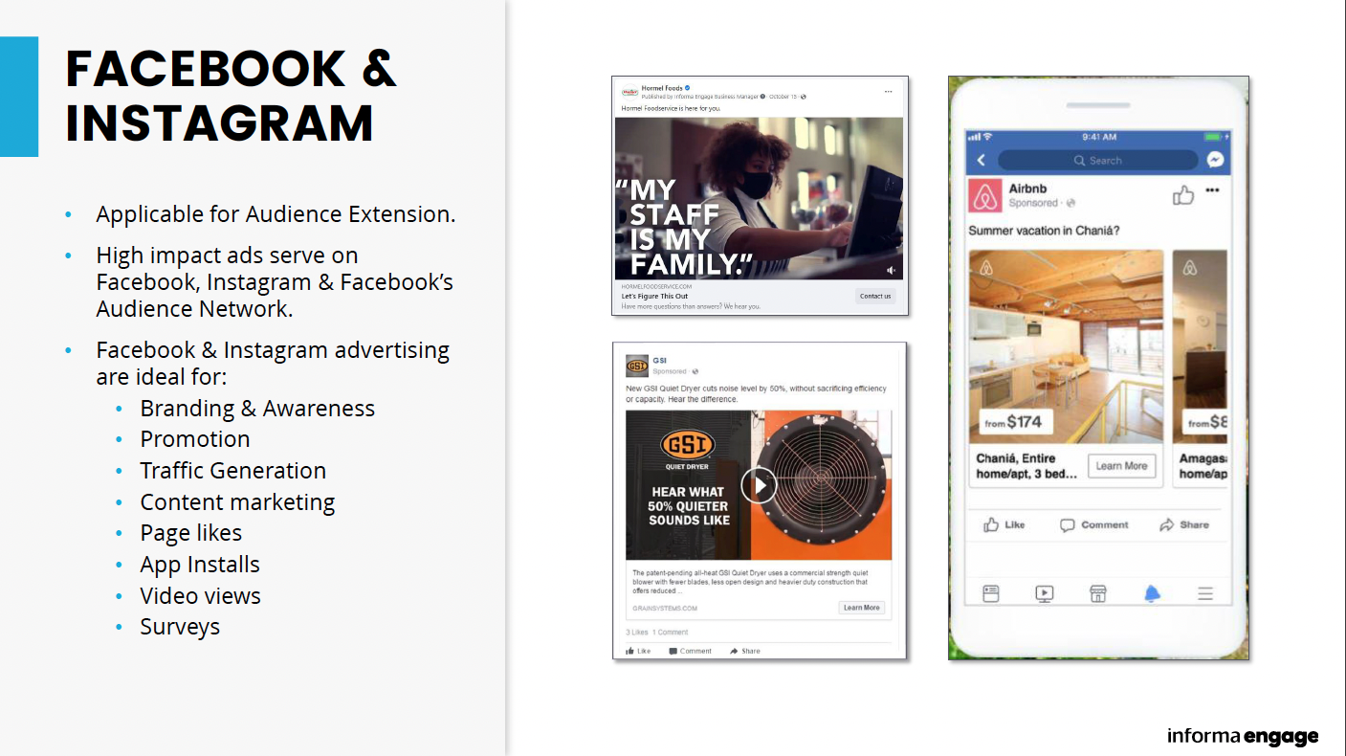

Slide 28
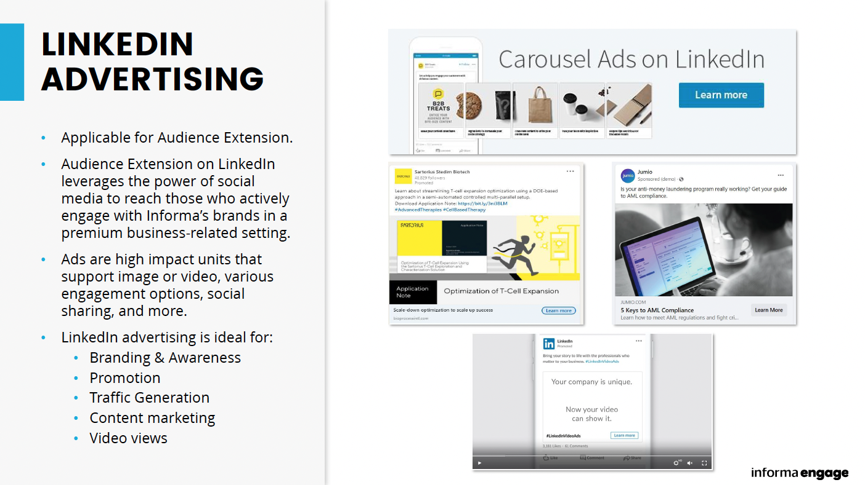

Slide 29
ACCOUNT-BASED MARKETING (ABM)

Slide 30
ACCOUNT-BASED MARKETING
Account-based marketing (ABM), also known as key account marketing, is a strategic approach that concentrates sales and marketing resources on specific targeted accounts and employs marketing campaigns relevant to the decision makers and influencers in each account.
How the program is executed:
Your client provides a list of accounts they’d like to reach
Depending on the type of campaign, we’ll either match that list across the web and apply titles/functions and industry, match the list to our database, and/or both
Client provides assets which may include HTML files and/or banner ads
Clients get visibility and engagement from high-value contacts as a result of targeting those accounts

Slide 31
ABM SEGMENT DEVELOPMENT
Account List
Client provides targeted list of companies
Matching Process
Conducted across our first-party database to identify influencers and decision
Audience Pool
Targeted Account-based Audience Pool is developed
IP Matching
Client’s key account list is matched to IP addresses and overlaid with job titles and functions
Marketing Programs Utilizing Client Assets
Email
Audience Extension
Facebook
LinkedIn

Slide 32
POSTAL & TELEMARKETING

Slide 33

B2B POSTAL MAILINGS
Direct mail is one of the most effective channels for B2B marketers. There is a tendency to delay B2B direct mail marketing due to the effort it takes to get it right. However, when done correctly, it often yields higher results over other marketing tactics, mediums, and approaches.
And the statistics speak for themselves:
There is a 79% engagement rate for direct mail
Response rate increases by 45% when digital and print marketing are combined
Direct mail requires 21% less cognitive effort to process and elicits a significantly higher brand recall than digital media
(Source: United GMG)

Slide 34

MAKING A COMEBACK
Direct mail is making a comeback in 2023, and it continues to deliver the best response rate, conversion, and ROI of any marketing channel. So, it's no surprise that, according to The Mail Shark, direct mail spend—at $38.5 billion—accounts for the largest portion of US local advertising spend.
Offering the same targeting options as email, direct mail relies on demographics, industries, geos, etc. with fewer opt outs. Pitch a stand-alone campaign or multi-channel with another DMS data product.
Direct mail is great for: catalogs, memberships, subscriptions, live events, web drivers, promotional sales, and any promo where something tangible would resonate!

Slide 35

Watch this space!
Brand Specific Product Showcase Meetings
Now that you know everything there is to know about data marketing products watch for an upcoming meeting for your team, individualized to your brand and market. In those meetings we’ll cover:
YoY sales and trends
Performance metrics for your brands
What is my team selling now and where can we grow?
Key segments
Case studies
Pricing recommendations
Sales packages

Slide 36
THANK YOU!

