Slide 1
Selling Lead Gen: Guidelines and Best Practices
April 2023

Slide 2
DEDICATED TEAM
CRISTEN MATTHEWS
Sr. Manager
Campaign Analytics
LAUREN MAJID
Sr. Manager
Campaign Marketing
JEN LUCE
Sr. Program Manager
Program Management
ANTHONY TREGLIA
Sr. Manager
Data Marketing Solutions

Slide 3
AGENDA
How Our Team Supports Sales
Frequently Asked Questions
Lead Generation Channels, Methods, & Processes
Reporting, Analytics, & Insights

Slide 4
HOW OUR TEAM SUPPORTS SALES

Slide 5
TRUSTED EXPERTS
Product
Innovation
Sales
Enablement
Program
Management
Drive Engagement. Accelerate Results.
Informa Engage is the global digital marketing services organization behind Informa’s prominent portfolio of trusted B2B brands.
With end-to-end expertise in digital marketing, lead generation, and virtual experiences, Informa Engage marketing services are strategically designed to accelerate engagement and results for Informa’s customers.
Packaged
Solutions
Strategic, Go-To
Market Development
Execution &
Delivery Lead
Data
Analytics
Creative
Design
Digital
Ad Operations
Pre-Sales Segmenting
Post-Sale Reporting
Design, UX, Web
Dev, Video
On & Off Website Digital Advertising Support
Digital
Events
Campaign
Marketing
Research
Commercial
Research
Webinars &
Virtual Events
Program Marketing
& Reporting

Slide 6
WHO WE ARE
CAMPAIGN
MARKETING
CAMPAIGN
ANALYTICS
PROGRAM
MANAGEMENT
Karen McAleer
Sr. Director
Campaign Marketing & Insights
Cristen Matthews
Sr. Manager,
Campaign Analytics
Jen Luce
Senior Program Manager
The Campaign Marketing & Insights team is comprised of SMEs who work together to build effective marketing campaigns and lead generation programs.
Our team works with you to:
Field pre-sales questions
Provide lead estimates
Consult with products
Execute campaigns
Drive meaningful results
Lauren Majid
Sr. Manager,
Digital Campaign Marketing
Dana Taggart
Sr. Associate,
Campaign Analytics
Emily Smolich
Program Coordinator
Gabriella Orpen
Associate,
Digital Campaign Marketing
INSIGHTS & OPS
Sean Gautney
Program Coordinator
Tara Pollak
Sr Dir, Audience Marketing Ops & Insight
Jillian Labruzzo
Associate,
Digital Campaign Marketing
Allen Tatara
Associate Director, Webinars
Cat Channon
Sr Mgr, Marketing Audience Analytics
DATA MARKETING
SOLUTIONS
Maggie Reynolds
Associate,
Digital Campaign Marketing
Anthony Treglia
Senior Manager, Data Marketing Solutions

Slide 7
WHAT WE DO
We are an extension of your team, with a sole focus of driving digital revenue through seamless marketing campaigns and lead generation solutions.
Our Approach:
Understand each brand’s unique digital revenue goals
Fulfill campaigns based on customer objectives
Provide lead guarantee expectations
Evaluate lead filter requirements
Market based on timing, volume, and audience reach
Uphold high standards to ensure client relationship is preserved

Slide 8
HOW WE DO IT
PRE-SALES CONSULTATION
QUOTE/RFP
ORDER
PM
EXECUTE
REPORTING
Our team plays a vital role with lead generation, beginning with the pre-sales process and continuing to final reporting.
Critical Steps for Success:
Accurate scoping
Achievable lead estimates
Feasible execution timeline
Insights and reporting

Slide 9
TRENDING PRODUCTS: NON-LEAD GEN SOLUTIONS
Below are the non-lead generating solutions that the Campaign Marketing & Insights team supports to drive awareness, audience engagement, and thought leadership.
01
FastChat
04
Audience Extension
02
Webinar Key Takeaway
05
Infographics
05
03
Custom Email & List Rental
06
Event/Product Guides

Slide 10
TRENDING PRODUCTS: LEAD GEN SOLUTIONS
Below are lead generation solutions we support to nurture leads, generate leads, and gain lead intelligence.
01
Webinars / Virtual Events
05
Custom Content
02
06
Surveys / Client-Facing Research
White Papers / eBooks
05
03
Content Gateways / CECs
04
Content Lead Touch / Webinar Lead Touch

Slide 11
CAMPAIGN QUESTIONS?
JUST ASK!

Slide 12
FREQUENT QUESTIONS, ANSWERED.
Q: Can we provide clients with a detailed marketing plan for how their digital program will be promoted?
Internal Answer: No, we cannot guarantee a detailed program, as each campaign could be different. Also, we outsource to Netline, and this should not be disclosed to clients. Contact Lauren Majid for any questions.
Client-Facing Answer: We do not provide detailed marketing plans. We can guarantee that your deliverable will be obtained (leads), but do not guarantee the promotional mix.
Q: Why don’t we promise # of email sends and specify total audience reach on the emails?
Internal Answer: That is proprietary information. The only concern should be the # of leads we are delivering or impressions whatever the KPI is. Contact Lauren Majid for any questions.
Client-Facing Answer: We do not guarantee a number of emails sent to our database or frequency; we only can guarantee the KPI to be delivered.

Slide 13
LEAD GEN CHANNELS, METHODS & PROCESSES

Slide 14
LEAD GEN CHANNELS
While there are several lead gen products, there are four main marketing channels we use to drive leads. The decision for which channels to use depends on accessibility, inventory, in-market teams, timeline, and budget. We work with you to understand which channels will meet client objectives and lead to successful outcomes.
EMAIL MARKETING
ON-SITE BANNER ADS
SOCIAL OUTREACH
FEE-BASED
Most successful channel
Highly accessible
Effectively drives leads while raising awareness
Dependent on available inventory
Drives awareness
Nurtures leads
Relies on in-market teams
Increases brand awareness
Critical for social influencers
Dependent on time and budget
Types include Lead Gen Purchase, Audience Extension, Fee-based social

Slide 15
EMAIL METHODOLOGY – PROPRIETARY INFO
Our team of experts delivers successful email campaigns by strategically segmenting data based on several data points and dependencies.
Segmentation is heavily based on:
Demographic, firmographic, behavioral, and intent data
Historical data
Client objectives and goals
Size and feasibility
Effective Frequency
Tracking Reports
Attrition Management
Micro-segmentation
A/B Testing
Personalization
Behavior & Response
Data-backed Segments
Trigger Emails

Slide 16
LEAD GEN SCOPING
Sales has client request for program
Sales sends an email to Marketing to scope out program
Marketing reviews audience criteria against database and receives volume/CPL quote and lead max from Netline
Sales provides quote to client
Marketing responds to sales (usually within 48 hours) with lead guarantee and suggested CPL to meet minimum margins
1
There are 5 essential steps in the initial scoping for lead generation solutions.
Before making client guarantees, it’s CRITICAL to speak with our team. This aids in program deliverability by:
Setting realistic client expectations up front
Generating desired outcomes
Ensuring program success
Program efficacy and achievability
2
3
4
5

Slide 17
HOW TO SEND A REQUEST
Subject Line: Quote Request – Client Name CS/WS – Brand Name (i.e., Quote Request – Datto CS – CF)
Send To: Lauren Majid, Gabriella Orpen, Jillian Labruzzo, Maggie Reynolds, Jen Luce
Email Body: Please include the following details:
Client Name:
Time Frame:
Program Type: content syndication/webinar/CEC/etc.
Job Title: list or attach selected picklist
Co Size: list or attach selected picklist
Geo: list out countries or region
TAL: y/n
Exclusion/Suppression: y/n
Custom Questions: y/n – if yes, please list the question
When scoping a lead gen program, we require an official email request before digging into audience data.
Please submit your email request with all fields completed.
PLEASE DO NOT FORWARD CLIENT EMAILS
Tips & tricks to make the back & forth more efficient:
Signature hack
Word doc to access
Save email to your DESKTOP
Notes:
d

Slide 18
KNOW YOUR PICKLIST
Sometimes, clients provide their own targets, but it is important that they choose from our picklists. This is why:
Set values for common demographic questions, including job title/function a d company type
Helps us qualify the audience and keeps our data clean – so we can strategically segment
Based on the selects chosen, Marketing can give you a certain number of guaranteed leads for a program
Easy to qualify/disqualify leads as they come through for the program
Note: Clients MUST select from our picklists before we provide you with a quote, as it streamlines the audience qualification process.

Slide 19
CONTENT SYNDICATION: TIPS FOR SUCCESS
To run a successful content syndication program, there are required assets and details that must be acquired before generating leads. See below for requirements:
Assets:
3-5 assets (i.e. eBooks, whitepapers, reports, educational content, top tip cards, etc. )
Variety of assets increases performance, as some may perform better than others
Note: the least effective types of assets for content syndication include non-educational videos, on-demand webinars, data sheets, and infographics.
Timeline:
3 months are recommended for effective marketing, but we can adjust accordingly
Most programs are sold in 3-month increments

Slide 20
BUYING LEADS

Slide 21
OUTSOURCING CONTENT SYNDICATION
Sometimes if a content syndication program has very strict filters, we will partner with an outside vendor to fulfill on a campaign. We do not tell the clients that we are outsourcing their campaign.
Why we may outsource:
ABM (Account Based Marketing) request – these tend to yield only a couple of thousand in our database, not enough for a lead gen program.
Less than 3 months to market
Strict filters that fall outside our pre-set options
Note: We always need email address domains from the client in order to pull a count in our database based on an ABM list. Company name will only result in a fuzzy match. Our outside vendors require it too.

Slide 22
NetLine – What you need to know
Informa Tech’s purchase of NetLine (late 2021) brought changes to lead gen for each Informa Tech brand. NetLine is a “white-labeled” capability of Informa Engage lead gen delivery.
There are 2 functions:
#1 Informa Tech requires all lead gen programs to use NetLine for lead forms and landing pages. Forms are now published on the NetLine platform on an Informa-branded site, like channelfutures.tradepub.com
#2 NetLine is now our marketing partner for lead purchases. When it is necessary to purchase leads, Informa Engage will use NetLine’s platform to promote the program to the NetLine audience ⎯ both in their database and across their network. Scoping the program and targeting practices remain the same whether we purchase leads from NetLine or promote to our own audiences.
NetLine is a technology platform used by Informa Tech and Informa Engage, but it’s also a standalone business with its own clients and sales pitches.
Notes:
Brands that want to publish the NetLine forms to their web sites, should reach out to the website's Product Manager to work with NetLine to set up the feeds for this.
Each Informa Teach brand has a NetLine platform “tradepub” site that is designed from and links to the brand’s web site to host reg forms and landing pages for content syndication assets and webinar sign ups.

Slide 23
NetLine – What you need to know
If NetLine cannot fulfill, we will rely on other partners including Integrate and Advance B2B.
If a client inquires about our NetLine relationship, refer to the NetLine Q&A page.
We DO NOT tell clients that we use NetLine to feed lead programs
NetLine charges us market-rate for leads; we will no longer receive the family discount from 2022.
We will provide updated CPL rate cards to ensure your client-facing CPLs are valued appropriately.
NetLine revenue supports Informa Tech digital revenue goals at a broader level – if you have concerns about margins or NetLine costs, please work with Annie McKnight.

Slide 24
TIMELINES

Slide 25
BOOKING CONTENT SYNDICATION
Include the following information in Salesforce when booking Content Syndication:
When offering a lead guarantee for a program spanning multiple months:
List the full guarantee along with all targeting/filtering information in the “AB Drop Notes section” on the Salesforce order (Lightning SF instance)
Add a line item/individual AB Drop ID for each month the program is running and split revenue evenly across months. Leads will be delivered as generated, we cannot guarantee even delivery across months, but this ensures we can call the revenue and stabilize forecasting, while delivering on the full guarantee by the end of the program
If a client requires CPL billing (please indicate, so we can adjust accordingly)
If contract will include lead gen: yes/no
Properly scoped with marketing team: yes/no
Include any applicable Drop notes, and in the “New IO” emails from Sales Ops to the PM and marketing teams, in Salesforce AB Drop notes
Signed contracts (if these are not included in SF, we cannot guarantee delivery)
Client deliverable and timelines (list them out)
Align with PM team on proposed client programs and standard delivery timelines. PMs should be involved in projected delivery month scoping.
If a client has urgent needs that fall outside the standard delivery time, PM must be contacted prior to contract
If bandwidth permits, we may be able to provide a rough production schedule to share at kickoff

Slide 26
Content Syndication - Client Deliverables & Timelines
Signed Contract Sent to Engage QA Team
PM reaches out to client with content submission form / deliverables
Content submission form is received and submitted to ECA Tasks
Client is provided links for review
Promotion begins
First lead report delivered by PM
(materials due 10 days before program start)
(24-48 hours after QA receipt)
(1-2 days)
(5 business days)
Day 1
Day 2-3
Day 3
Day 9
Day 12
1-2 weeks after promotion begins
Notes:
Align with PM team on proposed client programs and standard delivery timelines – they should regularly be involved in projected delivery month scoping.
If a client team needs something more urgently than standard delivery timelines allow for, this needs to be addressed with PM team before being contracted with client.
If bandwidth permits, we may be able to provide a rough production schedule to share with the client team at kickoff.
Standard content syndication program ramp-up timeline:
Signed contract sent to Engage QA team; assigned to PM team (24-48 hours after QA receipt)
PM reaches out to client team with Content Submission form and other deliverables needed (1-2 days)
Completed content submission form and deliverables received (materials due 10 days before program start)
PM submits content for landing page hosting (5 business days)
Client provided links for review/approval (1-2 days)
Promotions begin (5 days)
Weekly lead reports provided by PM (typically week after promotions begin)

Slide 27
Webinars- Client Deliverables & Timelines
Kick-Off Call
Content development and finalization
Webinar build development
Webinar platform training and final builds
Lead report sent to client
Title and abstract due and reg page built
*Please consult your Webinar & Virtual Experience Contact to advise/confirm all deadline dates *
(marketing begins)
Minimum 8 Weeks Out
7 Weeks Out
4 Weeks Out
3 Weeks Out
1 Week Out
24 – 48
Hours Post

Slide 28
CONTRACT IS SIGNED, NOW WHAT?
Work with your Program Manager to ensure all information has been provided prior to kickoff.
Client Deliverables & Creative Briefs:
If possible, please provide client teams with deliverable checklists and/or creative briefs to kickstart the planning of their custom programs (PMs can help provide these pre-contract, but it’s helpful to have them saved)
Crucial for clients to receive checklists and briefs if client is expecting a quicker-than-usual delivery turnaround
Program/Client Background Info:
Please provide any background info or info shared by the client team during the scoping phase
Oftentimes, this will help the PM teams update info needed during the kickoff calls and possibly be able to provide an SME from the start of a program

Slide 29
REPORTING

Slide 30
LEAD DELIVERY & INTERNAL REPORTING
Lead reports and reporting cadence are based on the products included in the program. See reporting delivery by product below.
Content Syndication, FastChat, and On-Demand Webinars:
Cumulative lead reports are sent to PMs weekly.
Included with lead delivering is a weekly lead gen pacing summary showing the net new and cumulative counts and goal for each program and including the Fast Chat stats.
Webinars:
Client report is sent to PMs the next-business day after the webinar
Virtual Events:
Sponsor reports are sent to PMs 5 business days after the live event
Content Engagement Centers (CECs):
Client report is delivered biweekly
**There is a 5-business day turn around for page build. Day 1 starts the following business day from content submission.

Slide 31
REPORTING FAQs
Q: How long is reporting provided?
Reports are provided until the lead goal is met.
Q: Is the report ready for the client and secure?
Each lead report is client-ready and password protected with the same password.
Q: What can a client expect if their reporting is integrated in their CRM?
If the client program has a real-time integration, their counts are in the summary, but there is no lead file.

Slide 32
Q&A

Slide 33
APPENDIX

Slide 34
FREQUENT QUESTIONS, ANSWERED.
Q: When running a custom email, what metrics are provided? Are a certain number of leads/messaging guaranteed?
Internal Answer: After a custom email is deployed, we provide the client with a live tracking link that gives them the metrics of the campaign. These metrics include open and click rates as well as metrics by specific URL. These emails are designed to give the client engagement using both our 1st party data as well as Channel Futures as the brand. We do not guarantee leads. The leads are a function of the client creative and messaging. Contact Anthony Treglia with questions.
Client-Facing Answer: Clients receive a live tracking link 2-3 days after the campaign has deployed. Metrics tracked: open rates, click rates, and metrics by URL. We do not guarantee leads.
Q: On a custom email, what is the format of the “from” or sender line?
Internal Answer: The ”from” line is formatted as from the clients on behalf of the specific brand. The credibility of the brand drives engagement to client creative. Contact Anthony Treglia with questions.
Client-Facing Answer: We use the client’s name and pair it with our brand name to drive engagement to the campaign. This increases credibility.

Slide 35
FREQUENT QUESTIONS, ANSWERED.
Q: What is Audience Extension and who do I talk to about that?
Internal Answer: The simple answer is that Audience Extension is a program that allows audience-based targeting across the web. We use our 1st party data to build audience segments based on the client’s targeting criteria. These segments are then served ads across the web and social media. Contact Anthony Treglia pre-sales counts, impression estimates, and product consultation.
Client-Facing Answer: Audience Extension is a program that allows audience-based targeting across the web. We use our 1st party data and match that with our target audience. The audience will then place client’s ads on brand safe sites and on social media platforms. Pre-sales counts, impression estimates, and product consultation can be provided.
Q: Can we send leads directly to my client’s CRM?
Internal Answer: Most likely! We can integrate to most CRMs to deliver content syndication leads directly to clients in real time. Contact Cristen Matthews for questions.
Client Answer: We can integrate to most CRMs to deliver content syndication leads directly to clients in real time, but we will confirm that we do in fact integrate with your CRM.

Slide 36
FREQUENT QUESTIONS, ANSWERED.
If you have questions relating to the FAQs below, please reach out to Tara Pollak or Cristen Matthews.
Q: Where is the landing page
Answer: Assets are published on Informa Tech’s NetLine platform, on branded pages that link to Informa Tech brand web sites, such as: https://channelfutures.tradepub.com/
Q: What is our total digital audience health, and how much has the audience grown?
Answer: Contact us for specifics.
Q: How do Informa Engage emails perform overall? How many have there been, and what is the opt-out rate?
Answer: Contact us for specifics.

Slide 37
FREQUENT QUESTIONS, ANSWERED. NETLINE
What is Tradepub.com?
TRADEPUB ⎯ is the content platform of NetLine. TradePub is referenced in the URL, like channelfutures.tradepub.com and in the from-line for content delivery emails. For more info, visit https://www.tradepub.com
Where are my client assets?
Assets are now hosted on the NetLine platform on the Informa Brand’s tradepub site, like channelfutures.tradepub.com . If an Informa Tech brand wants to also publish the NetLine forms & landing pages on their web sites also, they can work with NetLine to do that. Example: https://www.darkreading.com/resources
Are NetLine forms GDPR compliant
NetLine is updating their platform with direction from Gary and Compliance to be completely GDPR compliant. This will be complete by May.
How does the user get access to the client’s asset?
EMAIL DELIVERY ⎯ Whitepapers and other assets are delivered via email, using a branded from-line, like channelfutures.tradepub.com. This is a standard function of NetLine and cannot be changed.

Slide 38
Campaign Marketing and Insights Team FAQ
Digital and Campaign Marketing
(First Party Marketing – Sponsored Lead Gen – “Lauren’s Team”)
Sales FAQ | Internal Answer | External Messaging
Can we provide clients with a detailed marketing plan for how their digital program will be promoted? (email, social, etc.) | No- we cannot promise a detailed marketing program because each campaign could be different. We are also outsourcing to Netline, and we cannot tell clients that. | We do not provide detailed marketing plans - we can guarantee that your deliverable will be obtained (leads) and do not guarantee the promotional mix.
Why don't we promise # of email sends and specify total audience reach on the emails? | That is proprietary information. The only concern should be the # of leads we are delivering or impressions whatever the KPI is. | We do not guarantee a number of emails sent to our database or frequency; we only can guarantee the KPI to be delivered.
Why can't I share detailed email performance metrics of all emails, such as opens, clicks…etc.? | It's proprietary information, and we don't want the client to have that information about our databases. Also, with the use of Netline supplementing our campaigns that is also internal information that should not be disclosed to clients. | This is proprietary information that we do not share. We can guarantee your KPI to be delivered, we do not share email metrics.
Why can't we add clients as the seed list to receive all promotional emails for their campaigns? | We would prefer to forward a copy of the email if need be - we are constantly segmenting and testing and we prefer that the client not be seed on all our promotions. Also - we are marketing to our own audience, so we prefer they not dictate our messaging. Client should only be able to approve a landing page and not the email messaging. | We are always segmenting and testing and cannot add a seed to every email we send. If necessary, we can provide a sample HTML of one piece of marketing.

Slide 39
Campaign Marketing and Insights Team FAQ
Data Marketing and Delivery
(First Party Data Permissioned for Partner Sends – Anthony Treglia)
Sales FAQ | Internal Answer | External Messaging
What is audience extension and who do I talk to about that? | The simple answer is that Audience Extension is a program that allows audience-based targeting across the web. We use our 1st party data to build audience segments based on the client’s targeting criteria. These segments are then served ads across the web and social media. I am the main point of contact for pre-sales counts, impression estimates, and product consultation. | Audience Extension is a program that allows audience-based targeting across the web. We use our 1st party data and match that with our target audience. The audience will then place client’s ads on brand safe sites and on social media platforms. I am the main point of contact for pre-sales counts, impression estimates, and product consultation.
When running a custom email, what metrics are provided? Are a certain number of leads/messaging guaranteed? | After a custom email is deployed, we provide the client with a live tracking link that gives them the metrics of the campaign. These metrics include open and click rates as well as metrics by specific URL. These emails are designed to give the client engagement using both our 1st party data as well as Channel Futures as the brand. We do not guarantee leads. The leads are a function of the client creative and messaging. | We will provide the clients with a live tracking link 48-72 hours after the campaign has been deployed. The link updates in real time and gives a variety of metrics such as open and click rates as well as metrics by URL. We do not guarantee leads.
On a custom email, what is the format of the from line? | The from line will be formatted as from the clients on behalf of the specific brand. This way we use the prestige of the brand to drive engagement to the clients creative. | We use the clients name and pair it with our brand name to drive engagement to the campaign.

Slide 40
Campaign Marketing and Insights Team FAQ
Campaign Analytics (Cristen Matthews & team) or Insights & Ops (Tara Pollak & team)
Sales FAQ | Who To Ask / Quick Answers
What is our total digital audience health and how much has the audience grown? | Tara Pollak and team.
How do Engage’s emails perform overall? How many have there been and what is the opt out rate? | Tara Pollak and team.
Can we send leads directly to my client's CRM? | Yes! We can integrate to most CRMs to deliver content syndication leads directly to clients in real time.
Where’s the landing page? | Assets are published on Informa Tech’s NetLine platform, on branded pages that link to Informa Tech brand web sites, such as: https://channelfutures.tradepub.com/
Notes:
Re NetLine:
In 2022, Informa Tech shifted from using on-brand-site forms/landing pages to using their NetLine platform forms/ landing pages.
Brands that want to publish the NetLine forms to their web sites, should reach out to the website's Product Manager to work wtih NetLine to set up the feeds for this.
Re Compliance:
If clients have a privacy or consent statement that they woudl like to have added to the form, we can do that.
These appear as statements rather than and an additional Y/N question.
Campaign Analytics - Cristen Matthews & team - are responsible for:
• Create forms and landing pages for lead gen programs
• Lead Management including data quality and filter validation, client’s custom layouts and field/value transforms and integrations to client platforms for real-time lead delivery
• Deliver client lead gen reporting for content syndication, webinars, virtual events and custom programs like Content Engagement Centers (CEC)
• Distribute weekly lead gen pacing report for internal stakeholders (includes net new leads, cumulative leads, goal, current leads vs goal, by sales rep)

Slide 41
DETAILS FOR NETLINE FORMS AND LANDING PAGES

Slide 42
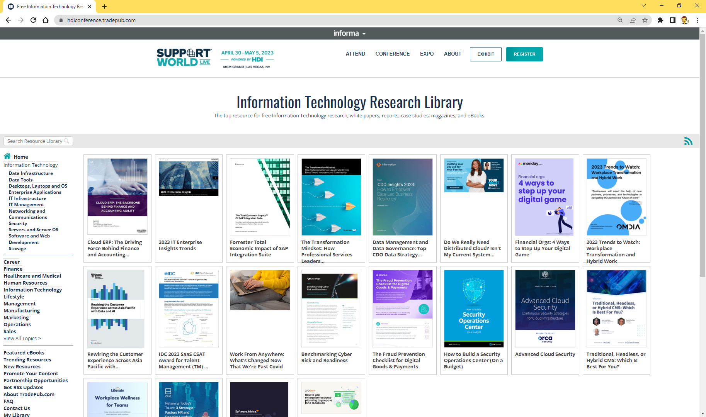
Informa Tech’s NetLine Platform Test Drive Your Brand’s NetLine Tradepub site, Form & Landing Page
Try It Out
◻ Visit your brand’s tradepub site, like channelfutures.tradepub.com
◻ Click on any Program
◻ Fill out the Form
◻ Note the STANDARD questions up top and the BRAND-SPECIFIC demos that follow
As users complete forms, NetLine’s platform remembers their responses and will only reveal the questions that are new or need a refreshed response. Over time, this makes the platform user friendly as forms are shorter and easier to complete.
Informa Tech’s brands generate new revenue from Informa’s audiences interacting with other content in the NetLine platform.

Slide 43
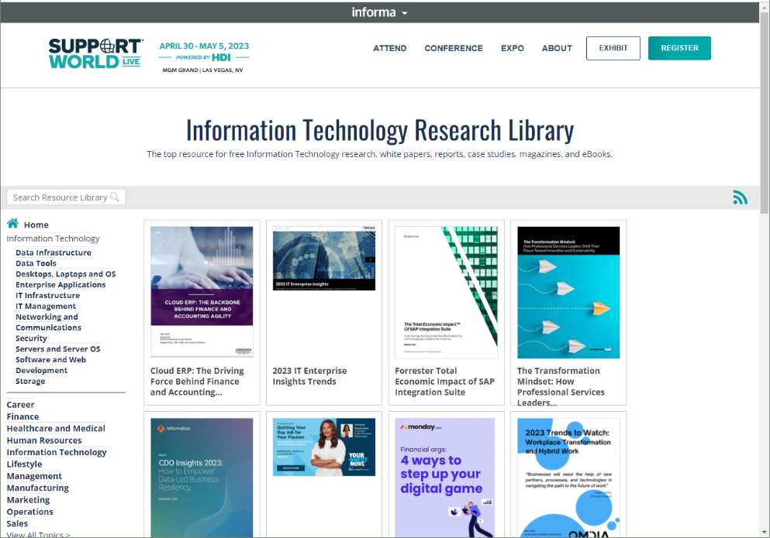
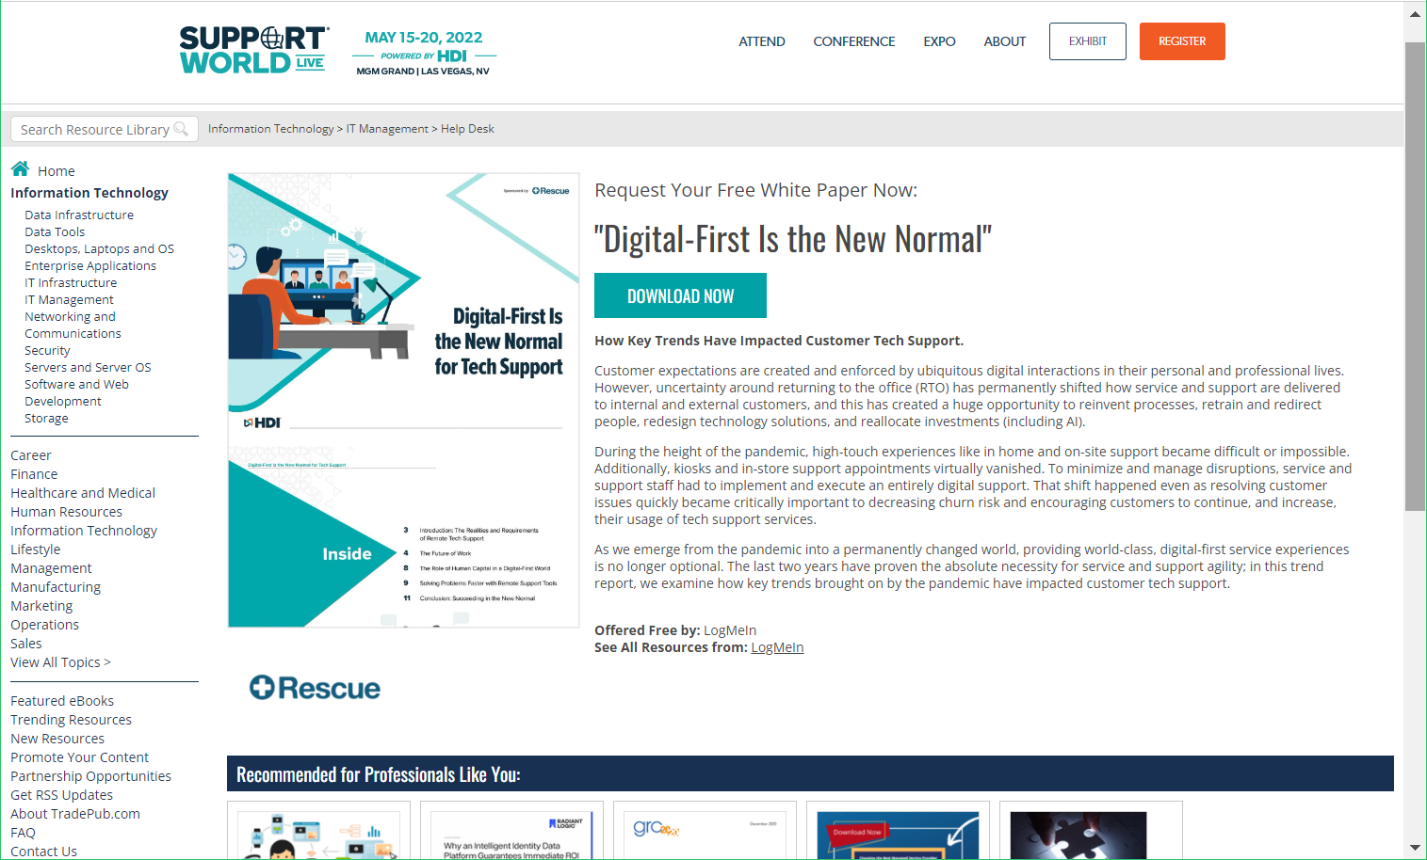
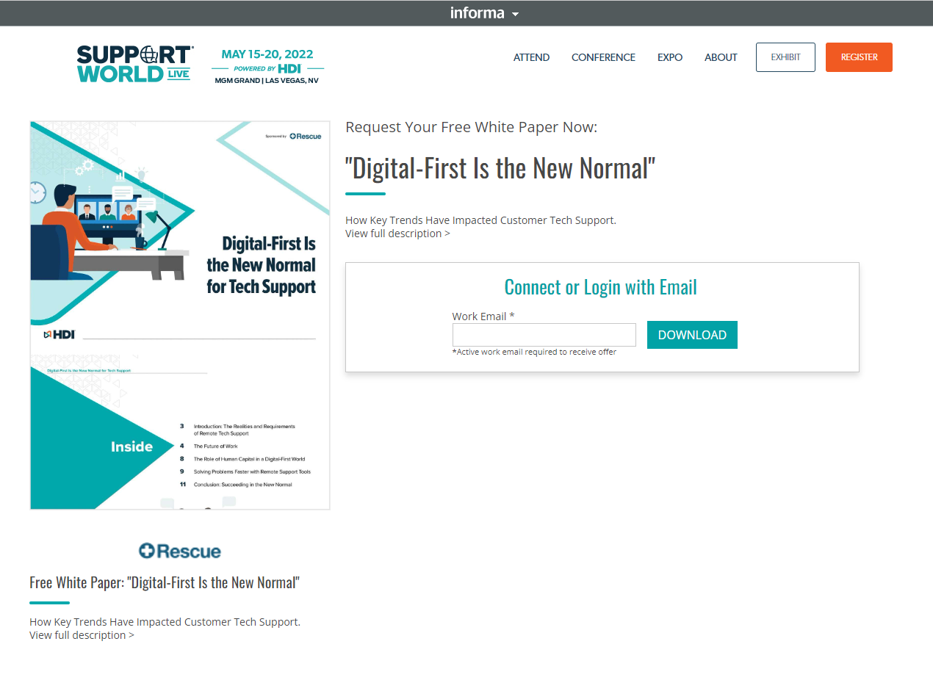
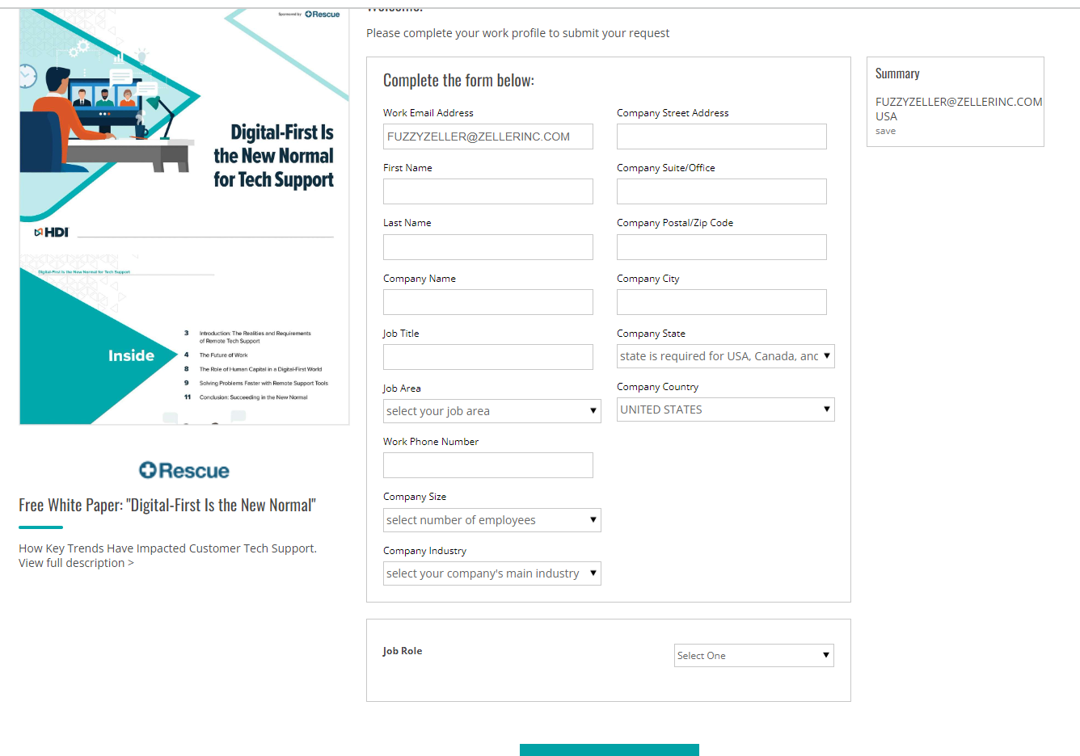
Informa Tech’s NetLine Platform Example of TRADEPUB site, Form & Landing Page
THIS IS WHAT USER SEES WHEN THEY CLICK ON FULL DESCRIPTION LINK
THIS IS THE INFORMA TECH BRAND’S SITE ON THE NETLINE PLATFORM; THE URL IS ALWAYS INFORMABRAND.TRADEPUB.COM
THIS IS WHAT USERS SEE WHEN THEY ENTER THEIR EMAIL ADDRESS
THIS IS THE FIRST PAGE THE USERS SEE WHEN THEY CLICK ON A PROMO LINK

