Slide 1

Webinars & Virtual Experiences
2023 Product & Capabilities

Slide 2

Agenda
Intro to WVX
Our Value Proposition
Products We Deliver
Expanded Capabilities
Working Together
Tips for Success
Trend Forecast

Slide 3
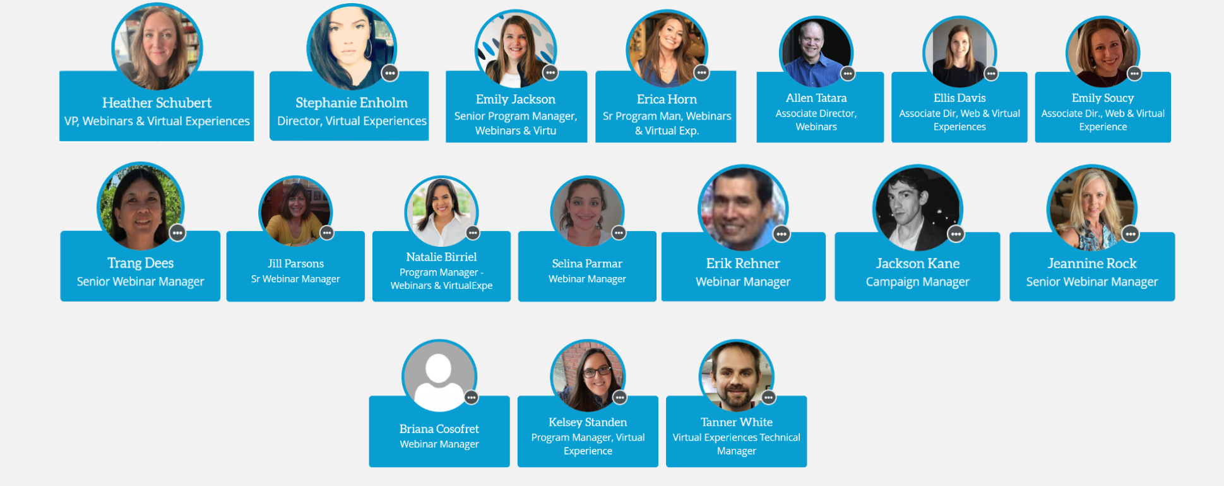
Meet the Team
Notes:
WVX standard for Webinars & Virtual Experiences. We are a global team, specialized in digital event excellence. Customers are at the core of our process, and we are experts in managing complex digital event and integrated programs, start to finish.

Slide 4



Points of Contact
Team Lead: Heather Schubert
Ellis Davis – Lead
Allen Tatara – Lead
Emily Soucy – Lead
Natalie Birriel
Trang Dees
Jackson Kane
Erik Rehner
Erica Horn
Emily Jackson
Jill Parsons
Selena Parmar
Jeannine Rock
All Virtual Experiences
Stephanie Enholm - Lead
** Briana Cosofret ** Tanner White ** Kelsey Standen ** OPEN HIRE

Slide 5

What we're made of...
Dedicated Experts with decades of experience in leading digital events for a variety of B2B industries, and a broad range of platform knowledge, particularly On24.
Perfectionists and People Pleasers aimed at delivering the highest quality webinars and virtual experiences to our internal partners and external customers. We fine-tune the process to ensure they are as successful as possible.
Curious Problem-Solvers who solve challenges by identifying the flex points in our platforms and process to find ways to say yes and save the day, whenever possible. We work closely with our vendors to identify and fix fault lines in the platforms and continuously improve the overall experience.
An Ownership Mindset that helps us deliver in a variety of ways to meet the business where it’s at; from technical production to full client-facing, end-to-end program management of webinars and virtual experiences. Whatever our role, you can count on us to own it and fully support it.

Slide 6

WVX: What’s the value?
Webinars and Virtual Experiences provide convenient, cost-effective, and immersive experiences for participants, while also offering various benefits for the organizers, such as brand alignment, audience connection, data insights, and lead generation.
WVX products can bring research, case studies, industry insights and opinions and news to life from your desk, with audience interaction.
Notes:
For participants, digital events offer the convenience of attending from anywhere in the world without incurring travel expenses or disrupting their work schedule. They can also access recorded content after the event, which allows for more flexibility in learning and knowledge retention. Webinars, virtual tradeshows, and digital events can also provide a more immersive experience through interactive features, such as live Q&A sessions, polls, and virtual networking opportunities.
For organizers, digital events can be a cost-effective alternative to traditional in-person events, as they eliminate the need for physical venues, catering, and travel expenses. They can also reach a wider audience and generate leads through the use of marketing automation tools, while also gathering valuable data on attendee behavior and preferences. Additionally, digital events can offer more flexibility in terms of scheduling and content delivery, which can make it easier to accommodate participants across different time zones.
Overall, the value proposition for webinars, virtual tradeshows, and digital events lies in their ability to provide a convenient, cost-effective, and immersive experience for participants, while also offering numerous benefits for organizers in terms of reach, data gathering, and cost savings.

Slide 7
WVX: The Numbers
Informa 2022
Total Webinars: 1507
Total Registrants: 588,597
Informa 2023 YTD
Total Webinars: 562
Total Registrants: 122, 593
Total Attendees: 259,534
Attendance Rate: 44%
Total Engagement Hours: 184,107
Total Attendees: 62,000
Attendance Rate: 51%
Total Engagement Hours: 77,646

Slide 8
Our Products

Slide 9
The Essentials

Slide 10

Elements for Success
Slides/Presenter Media
Video/Audio
Q&A Session
Related Materials
Speaker Bios
Surveys and Polls
Attendee Chat
Duration ~30-90 minutes.
Internal Branding
Customer Branding
SME voice/perspective
Audience goals
Registration/Opt-In
Marketing Campaign
Social Promotion
Reputable Speakers
Attractive Title and Description

Slide 11
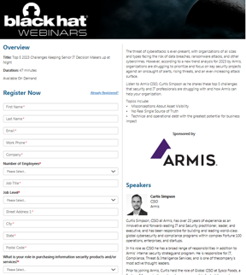
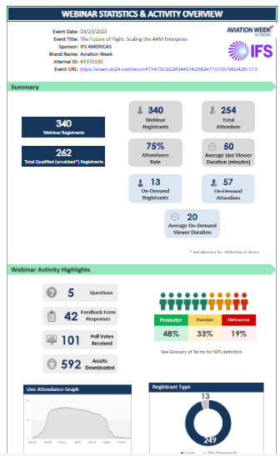
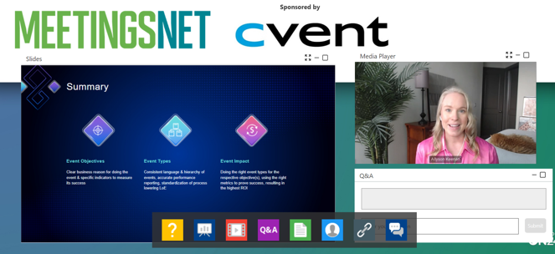
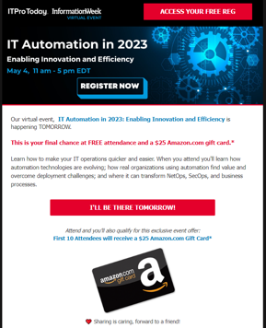
The Basic Formula
+
=
Promotion
Webinar
Results

Slide 12
Webinars

Slide 13
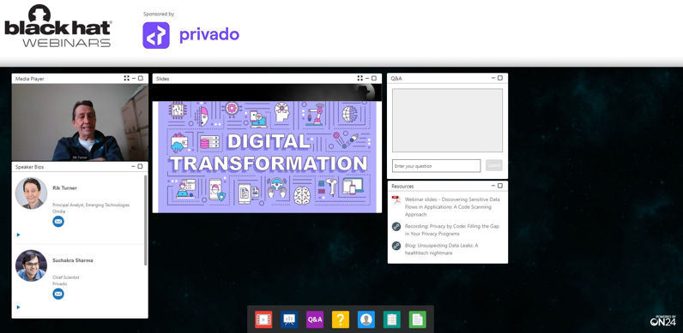
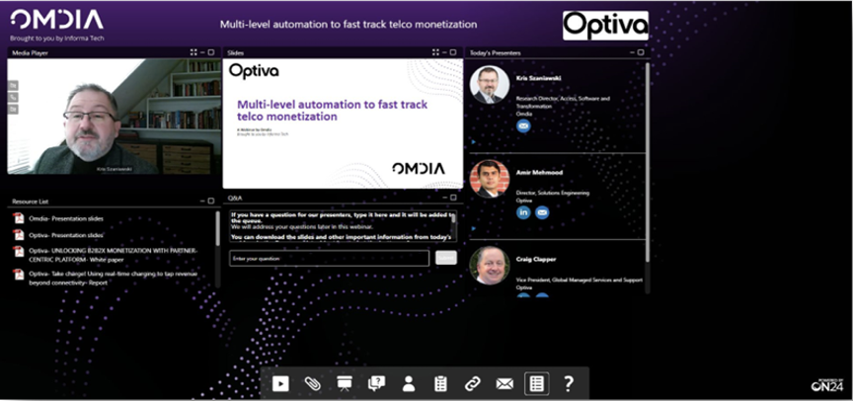
Analyst/Editorial-led Webinars
Analyst-led and Editorial webinars are created with industry-led topics and subject matter in mind, with a purpose to educate and inform the brand's audience. Customers can sponsor these webinars with limited involvement in the content, and at the discretion of the market leaders.
Customer Success Story:
Palo Alto Network sponsored 9 webinars in Dark Reading and 1 with Information Week in 2022. Average reg was 270+ with revenue of $25,000 per webinar. They have scheduled 4 webinars in 2023 thus far.

Slide 14
Analyst/Editorial-led Formats
Analyst-led model
The topic is identified by internal content teams and webinar presentation is based on analyst research.
Editorial webinar
An editor chooses the main speaker who will join the sponsor speaker on the mutually agreed upon topic. The sponsor may have a very limited speaking opportunity or may not even present at all.
Editorially driven SME
A group of experts curated by our internal content team that engage in a deliberation on a particular topic/questions
Content is driven by a sponsor, and for an additional fee, we provide a 3rd party SME (non-Informa) to present on the topic.
Webinar is based off of a study and the presentation highlights the results and market significance.
Panel Discussion
State of the Market

Slide 15
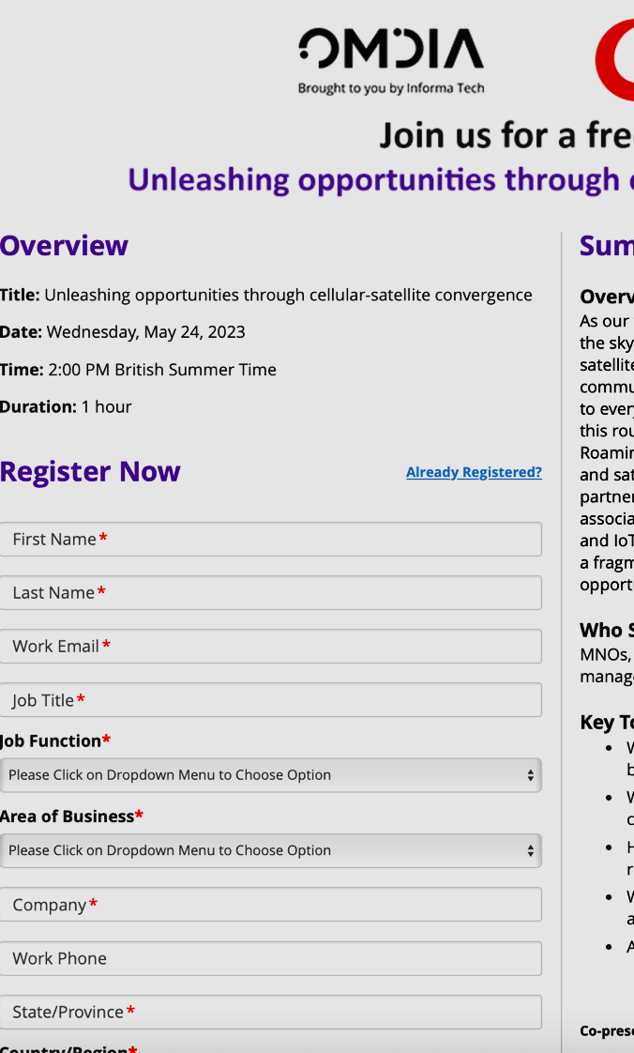
Analyst/Editorial-led Webinar Examples
Omdia Service Provider:
https://event.on24.com/wcc/r/4193198/B8A6BFE1DEDD3776FFAA6D94DFBD89F7
Dark Reading:
What's CNAPP-ening? Bring Your Cloud Security into Focus! Free Live Webinar (tradepub.com)
Black Hat:
Black Hat | Webinar: Top 5 2023 Challenges Keeping Senior IT Decision Makers up at Night
HDI:
How to build a resilient tech support culture and why it is critical to your team's success Free Webinar (tradepub.com)
Network Computing:
Does Your Network...NOT WORK? Eliminating Internet Unpredictability in 2023 Free Live Webinar (tradepub.com)

Slide 16
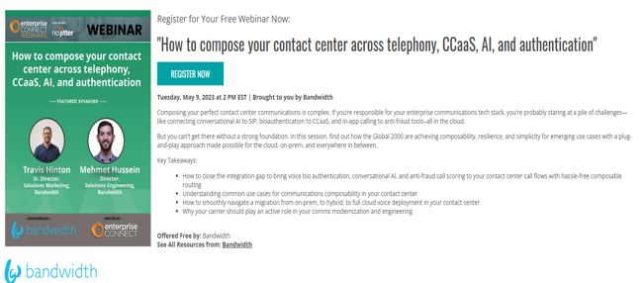
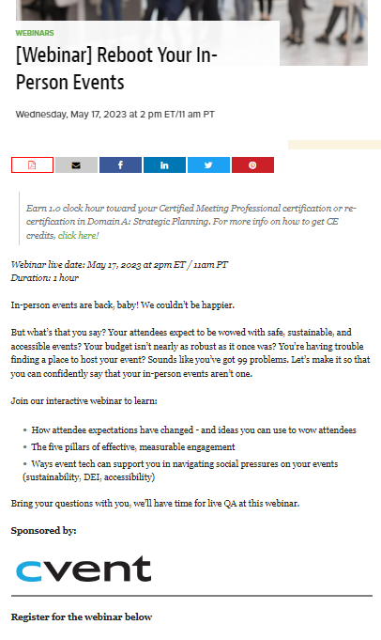
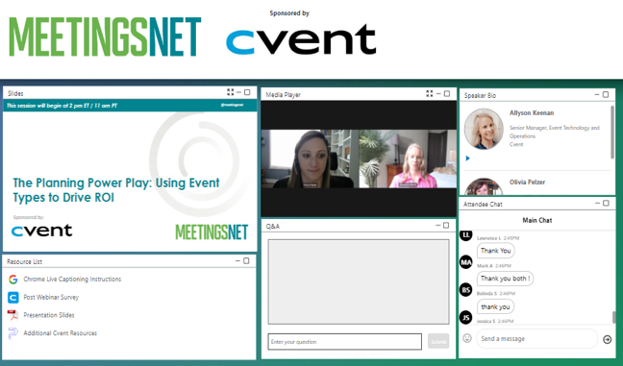
Customer-led Model
Custom Webinars are a unique opportunity for sponsors to align with Informa’s brands to present their own content to Informa’s audience. Sponsors can drive content with varying levels of involvement from Informa and 3rd party speakers, converting attendees to leads.
Customer Success Story
Cvent and MeetingsNet sponsored 8 custom webinars in 2022 (out of 17 total) and scheduled for 12 in 2023. Average reg in 2023 is 647+ and revenue is $11,990 per webinar.

Slide 17
Customer-led formats
Customer speaker(s)
Typically one to three speakers recruited by the sponsor, moderator provided by Informa.
Contracted SME/ 3rd party
One or more sponsor speakers, with a contracted SME and moderator provided by Informa.
Customer Panel
Several customer-provided speakers, each prepared with discussion points and moderator provided by Informa.
Demonstration/
Product Launch
Customer launch, includes product demonstrations and potentially a customer case study and moderator provided by Informa.

Slide 18
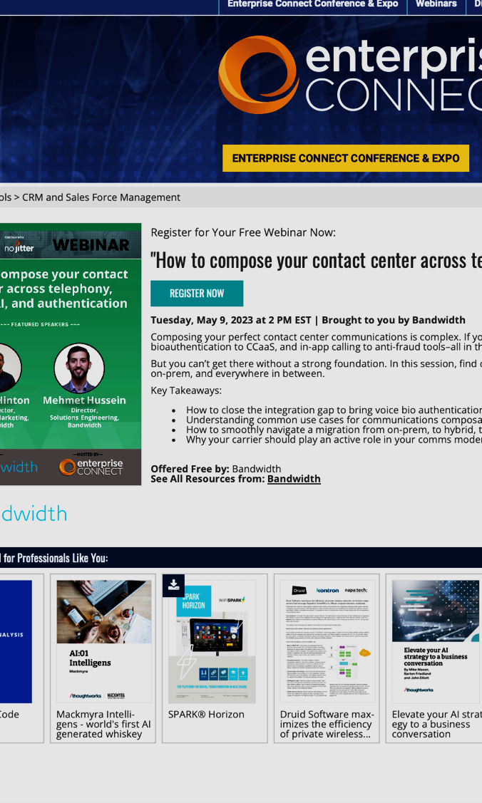
Customer-led Webinar Examples
No Jitter:
https://enterpriseconnect.tradepub.com/free/w_band09/
MeetingsNet:
https://www.meetingsnet.com/webinars/webinar-reboot-your-person-events
NRN:
https://www.nrn.com/webinars/everything-multi-location-restaurants-need-know-about-tiktok-advertising
Aviation:
https://event.on24.com/wcc/r/3578272/05D0CEC214C938E57111D5FFB2840534

Slide 19
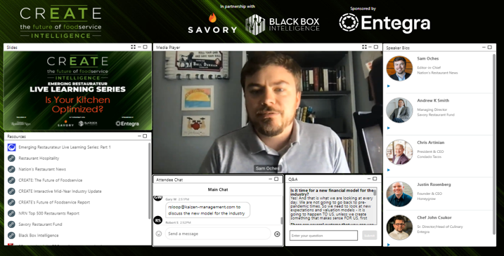
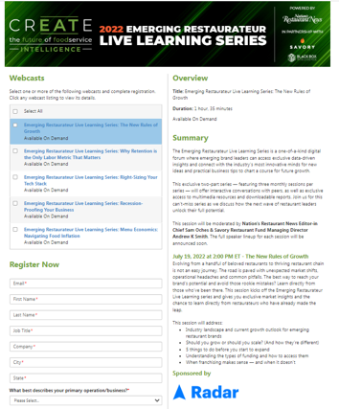
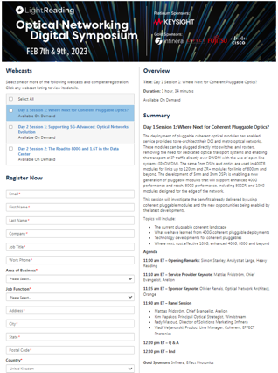
Multi-session Webinars
Multi-session webinars can be comprised of various formats, such as keynote, panel, demo, roundtables, fireside chat-style webinars and allow for a single large sponsorship, or several individual sponsorships associated to each webinar. The content is led and developed by Informa’s brands, but webinars, or panel speaking opportunities can be sponsored, creating more of a revenue opportunity. These programs can be customized to meet the objectives of the program, but they are essentially a string of standalone webinars, tied together with a single-point of registration.
Customer Success Story
NRN launched the Emerging Restaurateur Live Learning Series in 2022 that featured five sessions consisting of interviews, presentations and panel discussions in each session. The majority of the content was editorial driven.
Total registration averaged 886 per webinar, whereas the normal single webinar average registration in 2022 was 298.

Slide 20
Multi-session Formats
Multi-part series
A limited series, can be in one day, or over multiple days.
Digital Week
Full week of content under a larger program umbrella that expands over each day.
Continuing Education
Regularly scheduled educational programming.
Symposium
Multiple sessions tied into one topic/event over the course of 1-2 days.

Slide 21
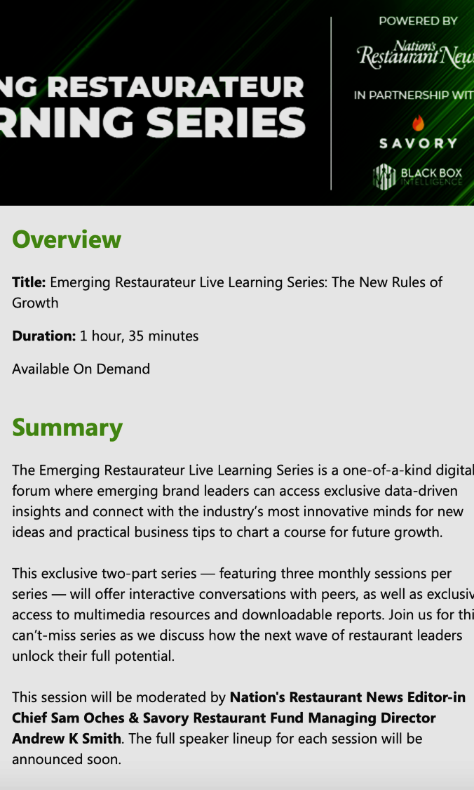
Multi-session Webinar Examples
NRN Emerging Restaurateur Live Learning Series:
https://event.on24.com/wcc/r/4101049/F690620D3A3C77B4515E2678D44BC527/4496316
Light Reading Symposiums:
https://event.on24.com/wcc/r/4041490/461CDFFD00D0DF8A5E70E3BA4C68FEB5/4379404
Agriculture's University of Minnesota Webinar Series:
https://event.on24.com/wcc/r/4017606/E325BAED8C637F9E3A5B7014E328A0FB/4408360
MDDI Qmed Webinar Series:
https://event.on24.com/wcc/r/3323554/CF614380321F9D3BC564923DF0B27F73/4353926

Slide 22
Extending Content After Webinar Ends

Slide 23
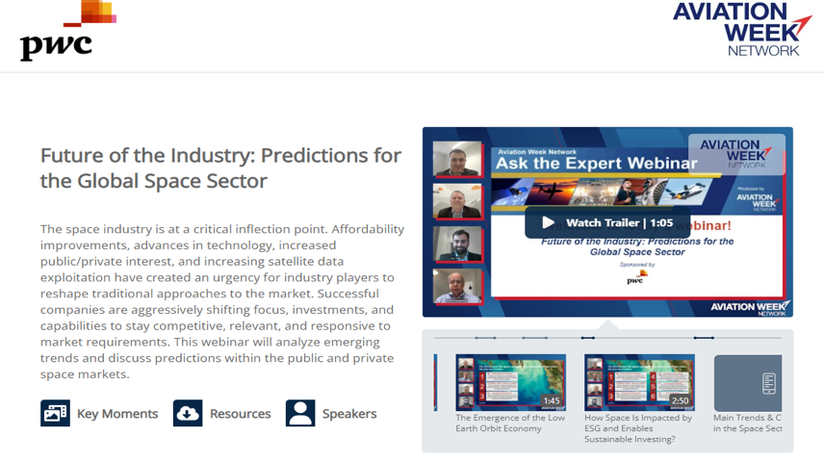
Content Multiplier
Overview
With Content Multiplier, marketers gain over 10 powerful content assets from just 1 webinar, event, or interview video. We work closely with our partners at Parmonic to create a comprehensive landing page that encompasses all the key moments from the webinar or event. The platform also creates a portal page where the client can utilize any of those moments for their own promotional efforts.
Deliverables Provided to Client
Interactive co-branded landing page
Portal web page with full suite of assets and export/share functionality
60-90 second video trailer, compilation of key moments
5-10 key moment videos (quantity dependent on length & topic)
5-10 key moment text transcripts
Full video text transcript
Full video with enhanced audio
Gif of each video
PwC:
Landing page: https://parmonic.ai/informa/lp/webinar/e85265de55f38eb0
Portal page: https://enable.parmonic.ai/sales/5d8434b163684e0d8cbca8d2f7ea3349
Wealth Management:
Landing page: https://parmonic.ai/informa/lp/webinar/bd2194e855c951c2
Portal page: https://enable.parmonic.ai/sales/d46f1a2cf14041e89e65bb794e50c451

Slide 24
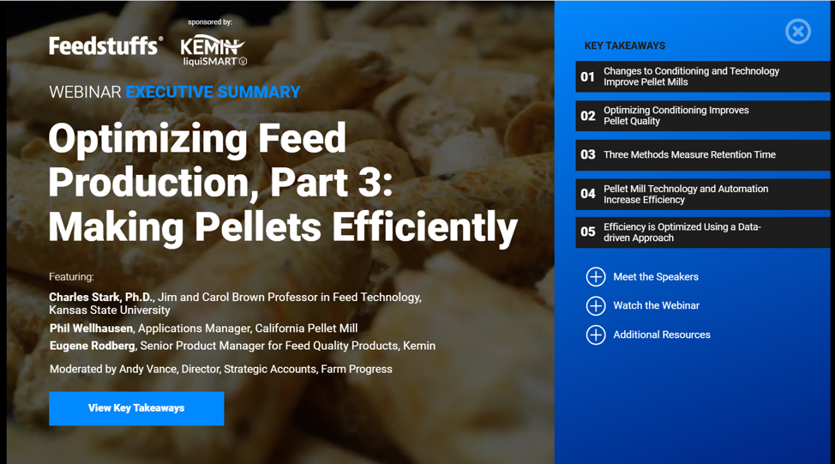
Key Takeaways
Overview
The real underlying value of a webinar is the content itself, which can serve as a continued catalyst to engage audiences well beyond the live event. This offering captures the central themes from a live webinar and breathes new life into the content by framing it through a visual, interactive experience. It’s designed to appeal to B2B executives who want the highlights quickly, want to consume on their own schedule, and be in control of their UX.
Deliverables Provided to Client
Development of web-based guide to capture webinar key points
3-5 key takeaways from webinar
Short video segments from webinar
On-ramp to full webinar (gated)
Up to three related assets and linked speaker bios
Marketing promotion campaign – 1 months
Engagement metrics reporting
Live duration period: 12 months
Examples
Agriculture: https://ix.informaengage.com/feedstuffs-webinar-optimizing-feed-production-part-3-making-pellets-efficiently/p/1
NRN: https://ix.informaengage.com/the-future-of-foodservice/p/1

Slide 25
Virtual Experiences

Slide 26
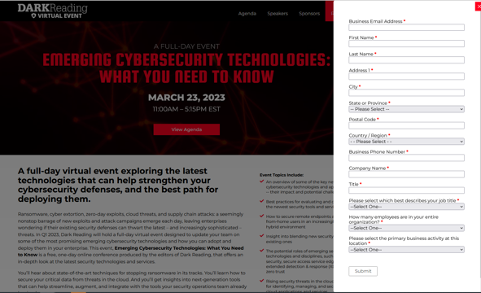
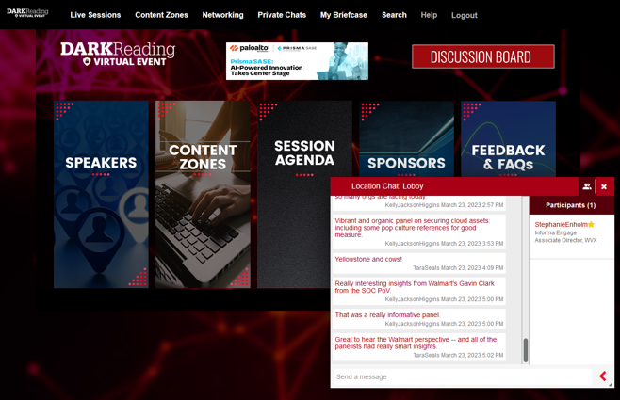
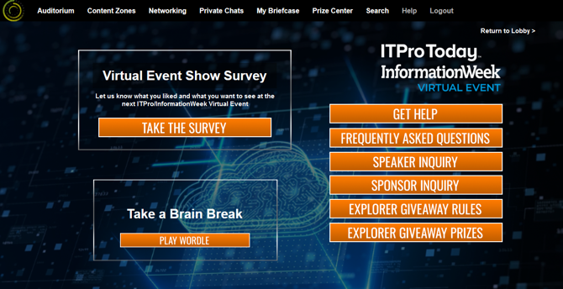
Virtual Events
A virtual event is a free to attend, gated virtual experience that revolves around a specific event day(s) that is held within an online, interactive environment with virtual areas that cater to both sponsored and planned editorial content. Instead of a single opportunity to connect with an audience, multiple sessions are organized to connect with attendees and focus on industry-led issues through webinar segments and sponsored provided, downloadable content pieces.
Elements may include:
Keynote, panel, demo, roundtable, or fireside chat-style structures.
Chat functionality that is both video and/or text based.
Editorial and/or sponsor provided content, organized by topics/themes related to the virtual event.
A single large sponsorship, or several individual sponsorships associated to each session.
Overall virtual experience topic, purpose, and goals developed and driven by Informa’s brands, with sponsor contributions on webinars and resource content

Slide 27
Virtual Event Variations
Virtual Conference
A gated multi-session virtual event that takes a more agnostic, thought leadership focus wherein content is divided amongst 3-4 focused topics within a content zones area, instead of the tradeshow style exhibit model. Event platform and all associated sessions are content remain available on-demand for 6 months following the live event day or days.
Virtual Tradeshow
A gated multi-session virtual event focused on a traditional, sponsor-focused set up in which each sponsor is provided a booth with an exhibit hall to house content and facilitate discussions with attendees. Event platform and all associated sessions are content remain available on-demand for 6 months following the live event day or days
Symposium
A mid-scale, single or multi-day, multi-session virtual event that utilizes a more streamlined approach and the focus is primarily the program agenda. Event sessions are discrete and tend to only house related content within the individual sessions as opposed to having a separate area.
Engagement Hub
A multi-day, multi session virtual environment, based on a recurring schedule of content and collected within a gated virtual environment. Most often using the eHub platform to organize live, recurring, and mostly on-demand content into a library, with no interactivity and networking capabilities.

Slide 28

Virtual Event – Dark Reading – By the Numbers
Brand: Dark Reading
Event: Understanding Cyber Attackers and Their Methods
Date/Time: November 17, 2022 | 10:30am ET – 5:00pm ET
Total Sponsors: 9
Total Revenue: $253,500
Total Returning Sponsors: 7
Number of Sessions (Keynotes, Panels, Spotlights): 14
Total Registration: 1,707
Total Live: 676
Total Unique Content Views: 2,512
November 2022 Example: https://vshow.on24.com/vshow/DRVE_111722?previewmode=true
March 2023 Example: https://vshow.on24.com/vshow/DRVE_March2023?previewmode=true

Slide 29
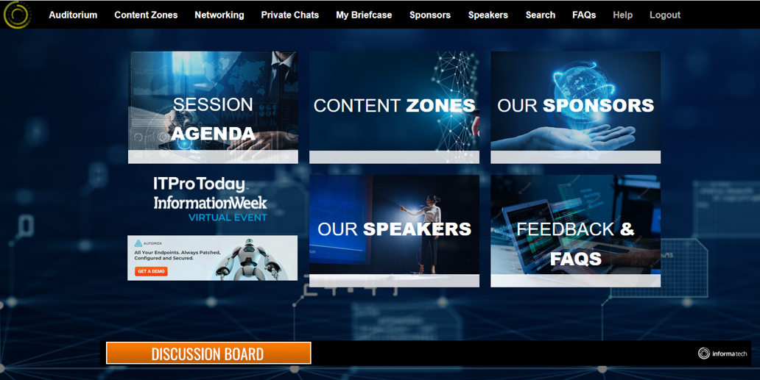
Virtual Event – ITPro/InformationWeek
By the Numbers
Brand: ITPro Today/InformationWeek
Event: How to Be Ready for Ransomware
Date/Time: August 18, 2022 | 10:30am ET – 5:00pm ET
Total Sponsors: 8
Total Revenue: $168,500
Total Returning Sponsors: 6
Number of Sessions (Keynotes, Panels, Spotlights): 17
Total Registration: 1,017
Total Live: 419
Total Unique Content Views: 2,754
August 2022 Example:
https://vshow.on24.com/vshow/ITPIW_Ransomware
May 2023 Example:
https://vshow.on24.com/vshow/ITAutomation_May2023?previewmode=true

Slide 30
Capabilities

Slide 31
Platform Capabilities
Webcast Elite
Engagement Hub
Virtual Conference
Group Licenses & Add-Ons
Engagement Hub:
On24's Engagement Hub is a content experience platform designed to feature live and on-demand webinar + content in a dedicated center.
Engagement Hub provides a range of personalized content options, including webinars, videos, eBooks, and other multimedia content, to help businesses create a more engaging and interactive content experience.
Webcast Elite:
On24's flagship product, Webcast Elite, is a comprehensive digital experience platform that enables us to create and analyze webinars.
Webcast Elite provides a range of customizable templates, branding options, and multimedia tools to help us create engaging webinars.
Virtual Conference:
On24's Virtual Conference product is a comprehensive solution for creating and delivering virtual conferences, trade shows, and other large-scale events.
Virtual Conference provides a range of customizable templates, branding options, and multimedia tools to help businesses create a fully immersive and interactive virtual event experience
Group Licenses & Add-ons:
Available for On24 workspaces (by Brand) for these features:
  Broadcast Video Enablement
  Advanced analytics
  Captioning/Accessibility
  Marketing Connectors
Add-ons for Webinars:
  Translation services
  Creative services
  Production services
  Chat/breakouts
  Full-service webinar management

Slide 32
Working Together

Slide 33

Business Intake
Engage has a dedicated Intake and Quality Assurance team to oversee all incoming Marketing Services business, ensuring all key metrics are tracked accurately in the Marketing Services tracking system. This team connects the dots to salesforce closed won business, and to ensure that our customers receive accurate outreach in a timely manner,
  Required Information to Onboard Webinar and Virtual Experience Programs
Product Description/ Format
Event Date/ Timeframe
Brand, Client details, Sponsorship
Contact info
Revenue/ Revenue projections
Target audience/ Lead requirements
Special requests, information required for seamless customer experience
Min 8 weeks for a webinar, 12 weeks for a VX, 4 weeks for VX sponsorship

Slide 34
Typical Webinar Workflow
START HERE
RECOMMENDED: Initial product consultation with Engage sales enablement partner.
PRE-ASSIGNMENT:
Book sold/won business with Engage QA Intake team
Intake team handles assignments to appropriate PM team.
WVX PM aligns with internal team (other PMs, sales reps, editors) before client outreach.
KICK OFF: WVX PM initiates client kick-off and creates timeline
Project kick-off takes place, all deliverables and deadlines are clearly communicated.
PHASE 1: Content planning and lead up to registration launch.
Phase 1 materials due
Marketing team builds out registration and email campaigns
Registration and Campaign Launch
PHASE 2: Registration campaign in progress, Content finalized leading up to webinar.
Phase 2 materials due; all configuration complete
Training/Prep call, final edits in place
Live Webinar
POST WEBINAR: Archival, Mp4 creation.
Post webinar reporting delivered; reporting schedule set based on contract.

Slide 35
Sales
Prepared to work on program.
Agrees to follow process to ensure a successful result.
Operations
Liaise with sales for business intake and requirements, ensuring all necessary information is provided up front for clear hand off to the delivery team.
Supports workflow systems for project tracking.
WVX PM
Main delivery POC for webinar project post-sale, collabs with other content PMs and brand PMs where needed.
Content Lead
Campaign Mgmt
Customer
Responsible for identifying right products for customer.
Seamless hand-off between client and delivery.
Accurate and complete paperwork.
Customer relationship owner.
Owns all deliverables assigned to them.
Outlines all content and logistical needs, tracks and manages deliverables, coordinates production.
Leads training, handles technical aspects.
Ensure all elements of project launch on time, on budget, and oversees all quality outcomes.
Depending on the model, this role could live inside or outside of Informa, and even be supported by multiple individuals.
Identifies speakers, liases with PM on deliverable timing and connects speakers to PM.
Identifies webinar subject, goals and purpose for the webinar.
Ensures speakers are on the same page for content planning.
Supports and participates in training call and live event.
Team will manage marketing aspects, such as registration setup, audience segmentation & acquisition, campaign marketing, social media marketing, and performance analysis.
Identify and resource additional support as needed; ie. moderators, creative, etc.
Completing the sale within the product timeframe required for delivery.
Depending on the group, this role may be a combination of roles inside Informa, including the Engage Campaign Marketing Insights team, and the brand marketing team.
Reporting & Analytics
Engage CMI Reporting and Analytics team supports Netline reg page builds.
Team produces client-facing reports for webinars and virtual experiences, based on customer requirements and lead targets.
Roles and Responsibilities

Slide 36
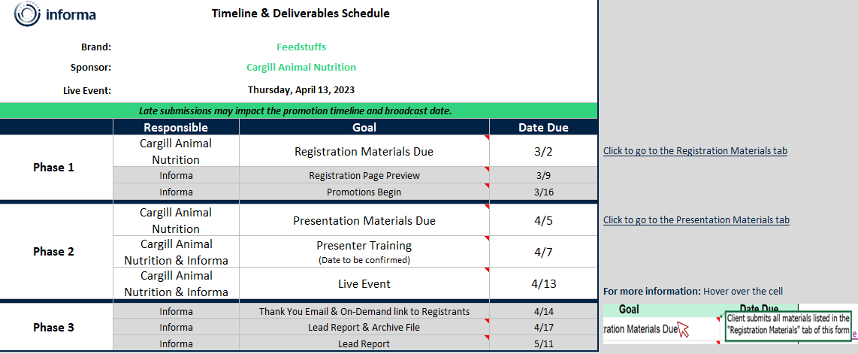
Sample Webinar Timeline

Slide 37
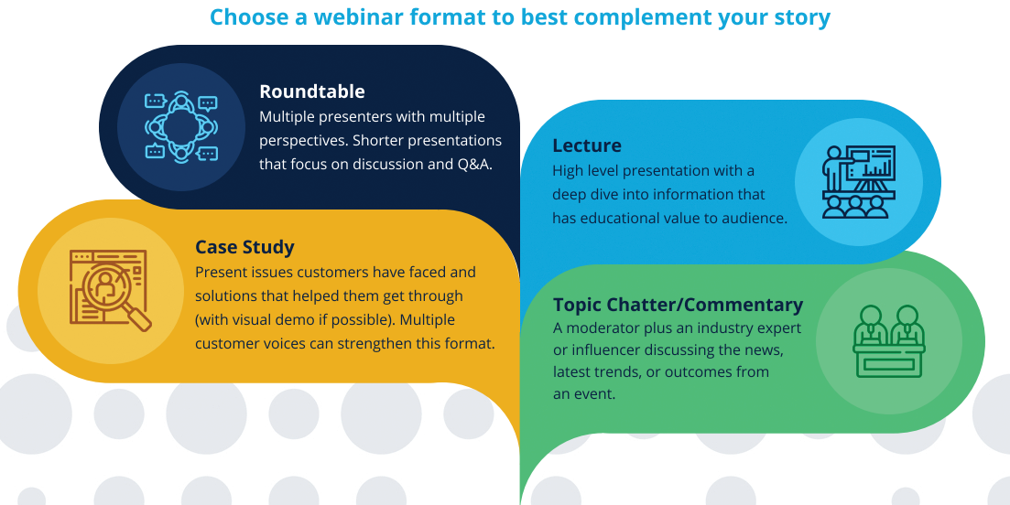
Sample Resources: Best Practices on Format

Slide 38
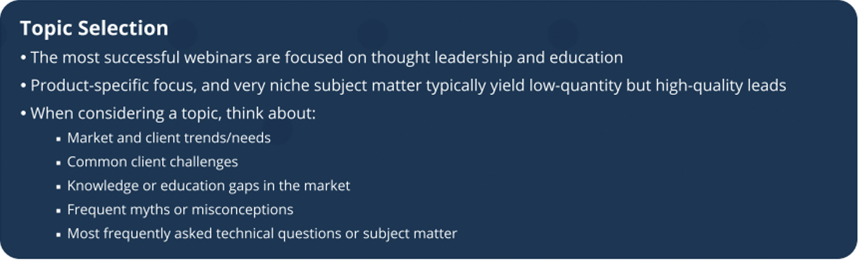
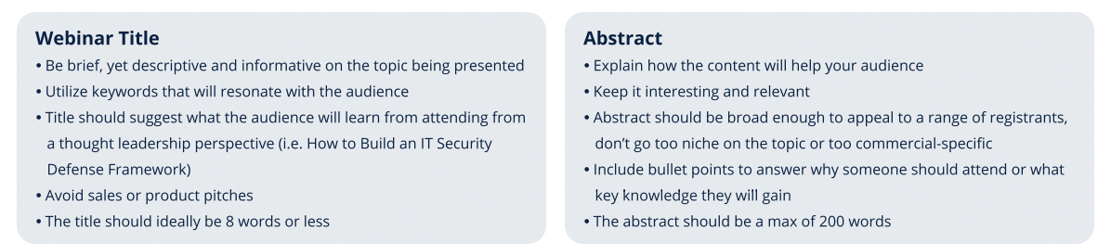
Sample Resources: Best Practices on Content

Slide 39
Recommendations

Slide 40

Tips for Success
Partner closely with Engage from the onset for sales enablement/product support.
Know (or get to know) your audience, through Engage CMI team guidance.
Identify a lead SME (or several)
Offer a variety of WVX packages and bundle additional products
  Leading in: Research, Advertising
  Following up: Content Multiplier, Key takeaways
Know what your customers want, and will get out of this
  Increased brand awareness
  Lead generation
  Thought leadership/ alignment
  Access to Informa audience
Give customers time - a solid 10-week timeline for webinars, and 6+ weeks for VX sponsorships.

Slide 41

Trend Forecast
1.) Increased Use of Webinar Video: The global webinar market is estimated to reach 800 million this year (2023), up 253 million from 2015 (MarketWatch)
2.) Extending the Life of Webinar Content: Prospects are 60x more likely to convert if a webinar includes marketing materials afterward (ReadyTalk).
3.) Data-driven Insights: 8 in 10 marketers say that webinars lower their cost-per-lead (On24).
4.) Personalized and Targeted Content: 70% of B2B professionals are seeking tips, tricks, and best practices relevant to their role. (Search Engine; Journal).
5.) Speaker Interaction & Resources: 81% of marketers use Q&A as an engagement tool during webinars, 69% provide resources for download. (On24)

Slide 42
QUESTIONS?

Slide 43
Appendix

Slide 44


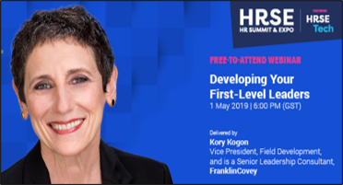
Webinar: Driving Demand Leading Up To An Event
CASE STUDY
Client Objective
FranklinCovey is a world leader in consulting and training, enabling individuals and organizations to achieve results that require lasting changes in human behavior. The company needed a solution to build the presence of a key thought leader in the Middle East region. Its mission was to obtain qualified leads to increase the number of registrations on their training courses.​
Informa Solution
Based on the objectives, Informa recommended an interactive webinar program. A senior representative from FranklinCovey was allocated 60 minutes to showcase their expertise and thought leadership on a chosen topic. This consisted of a 50-minute presentation followed by 10 minutes of Q&A. The presenter was also a keynote speaker at the forthcoming HRSE (HR Summit and Expo) event and actively promoted her speaking slot at the event. ​
Program Results
FranklinCovey’s partnership with HRSE on this campaign resulted in over 970 new qualified leads with over 190 viewing the event live. Of these leads the vast majority were buy side with over 50 questions asked showing great audience interaction. The video recording from the webinar is currently available at the HRSE resource center behind a registration form to allow us to generate further leads from this content in the lead up to the event.​
WEBINAR LEADS
970
Total Leads from Webinar
LIVE EVENT LEADS
197
Webinar Leads Who Then Attended the HRSE Event
TARGET
97%
Of Event Attendees Who Matched Targeting Criteria
INTERACTION
28%
Avg. Interaction Rate of Audience During Q&A

Slide 45

Virtual Event – Dark Reading Case Study
CASE STUDY
Dark Reading's November event proved to be a remarkable gathering for cybersecurity enthusiasts, drawing attention from industry experts and professionals alike. With a total of 1,707 registrations, the event created a platform for attendees to deepen their knowledge of the cybersecurity threat landscape.
The 14 sessions, featuring captivating keynotes, panels, and spotlights, covered a diverse range of topics, ensuring that participants received a comprehensive understanding of the subject matter.
The engaging content and expert insights led to a substantial number of live attendees, with 676 individuals actively participating in the event on the live date.
This event also enjoyed strong sponsorship support, with a total of nine sponsors contributing to its success. The event's track record and reputation attracted seven returning sponsors, demonstrating their confidence in Dark Reading's ability to deliver valuable and impactful content. The total revenue generated from these sponsorships amounted to an impressive $253,500, highlighting the event's significance within the cybersecurity community. Moreover, the event's reach extended beyond just the live sessions, as evidenced by the 2,512 unique content views.
This Dark Reading event stands as a testament to the brand's commitment to providing high-quality cybersecurity content. By successfully convening industry experts, attracting a substantial number of attendees, and securing strong sponsorship support, Dark Reading further solidified its position as a trusted and influential source of information in the cybersecurity field.
November 2022 Example
March 2023 Example:

