Slide 1

INFORMA ENGAGE
Product Sell Sheets

Slide 2
ADVERTISING SOLUTIONS

Slide 3
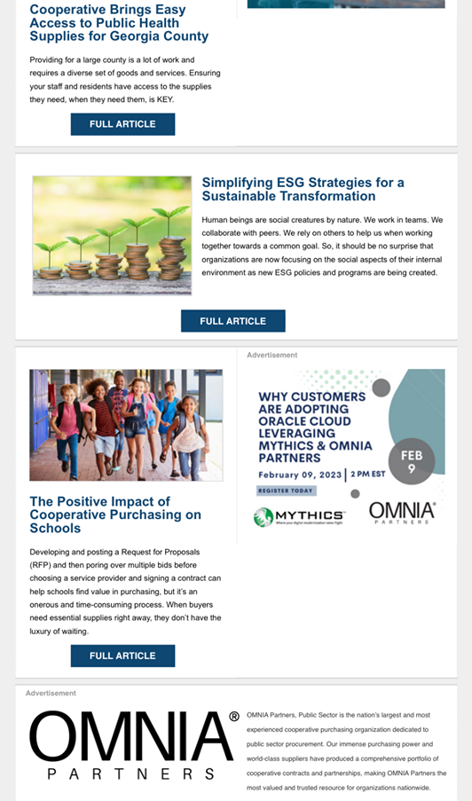

BRAND E-NEWSLETTER
ADVERTISING
Staying top of mind with your target audience means engaging them across multiple channels. Advertising in Informa’s well-read brand newsletters places your message alongside valuable industry news, columns, best practices and more.
Reach your target audience with ease using advertising through highly received e-newsletters. Daily, weekly or monthly—your brand delivered directly in the inboxes of professionals.
Product Details
Advertising placements in Informa brand e-newsletters
Ability to choose from focused editorial e-newsletters
Frequency, circulation count, and ad units vary based upon each e-newsletter
Reporting metrics include clicks, opens, and CTR

Slide 4
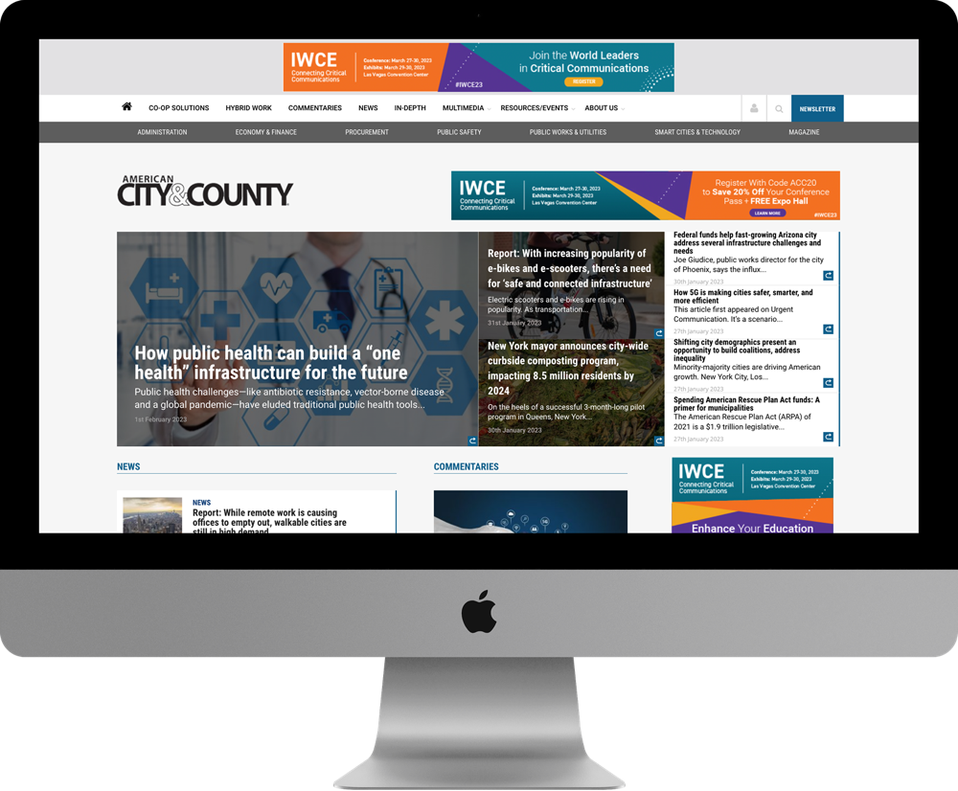
BRAND SITE ADVERTISING
Buyers connect with your brand at various stages of the buying cycle. That’s why it’s vital to give them opportunities to engage with your brand across multiple channels and devices.
On-site digital advertising solutions are a great way to increase brand awareness, improve brand recall, drive traffic to your website, and build relationships with potential customers as they research new product and solution purchases.
Product Details
Advertising placements on Informa brand sites
Build brand awareness, expand reach, and drive action
Nurture prospects during research, consideration, and decision stages
Reporting metrics include clicks, opens, and CTR

Slide 5
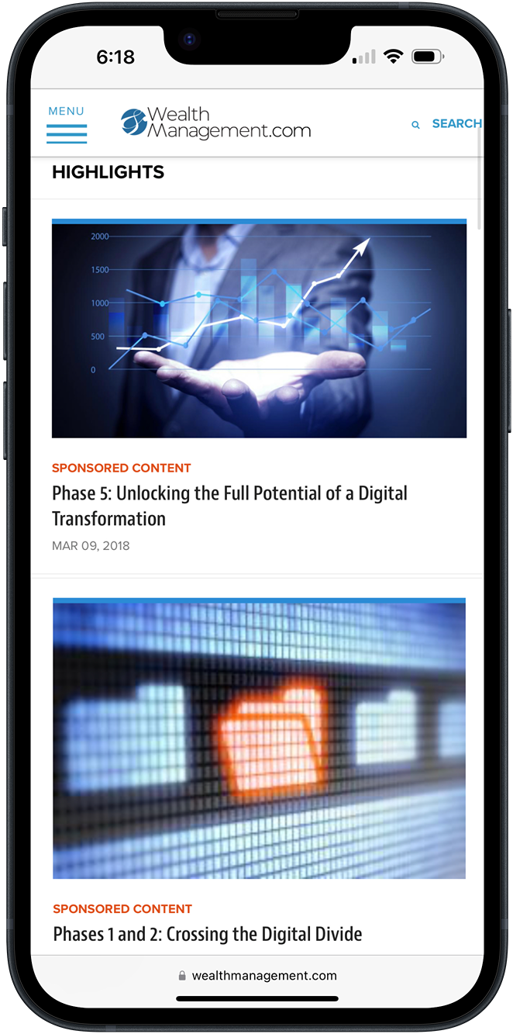
CONTENT CHANNEL SPONSORSHIP
Align your products and services with one of Informa’s established industry brands to generate awareness and position your company as a thought leader in your industry. Informa’s Content Channels give you an exclusive, competitor-free environment to surround your brand with a relevant topic of your choice.
Your assets live on a dedicated landing page with our brand-trusted editorial content. Enhancement options include custom content, sponsored content posts, webinars, research, and in-feed native ads.
Product Details
100% exclusivity and customized channel design
Mix of editorial and sponsor content
Ability to surface sponsor assets and social feeds
Option to run banners across associated channel pages
Promotional marketing campaign and monthly reporting included

Slide 6
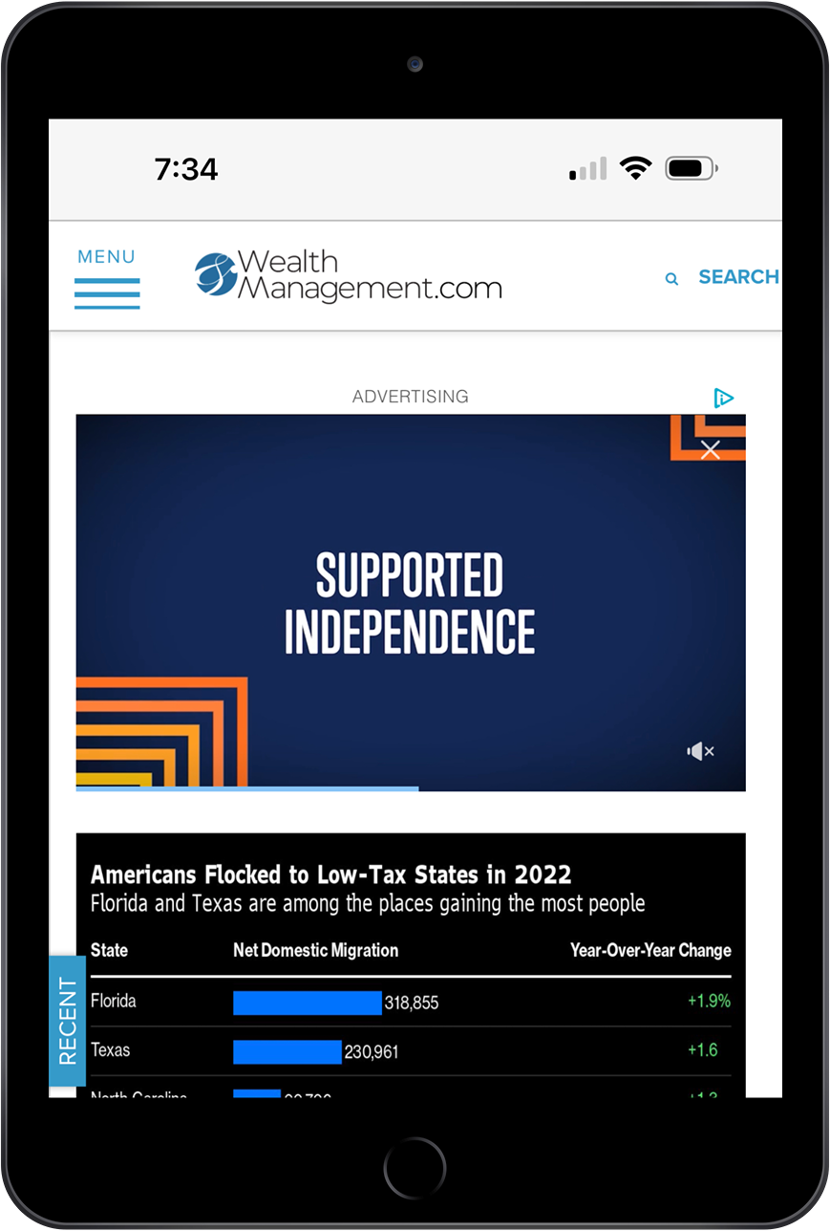
IN-ARTICLE VIDEO
ADVERTISING
Stand out from the noise and capture your audience’s attention with an immersive, visual, and audio experience that is non-intrusive to users. Advertising with in-article video engages an audience already interested your brand’s industry.
An ideal way to deliver video ads to a highly targeted audience, in-article video advertising provides an optimal user experience that provides relevant information. Engage with your audience through short video placements that lead to guaranteed viewability.
Product Details
Optimal user experience
Video plays when 50% visible on a user’s screen
Audio and video start upon user click
Premium environment to capture viewer attention
Featured, short 30-60 second videos

Slide 7
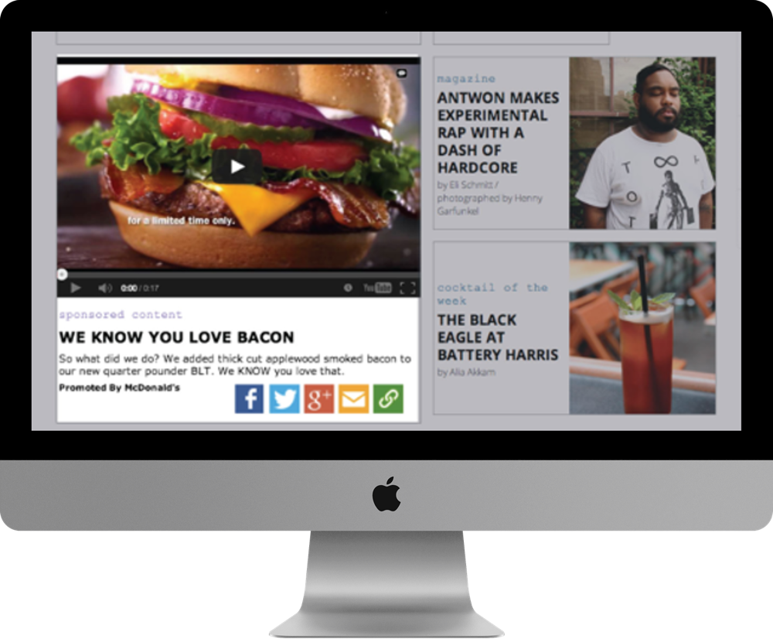
NATIVE ADVERTISING
You’ve made the investment to create high-value content. But, are you getting your content in front of the right prospects? Native Ads do just that by placing a compelling headline, image, and link back to your content seamlessly into a site’s content flow. Native ads can be placed on Informa websites, across the web, or on social platforms.
When placed across the web or on social, Informa’s first-party data powers your campaign to help target prospects with accuracy.
Product Details
Brand: In-Feed Ad placement on an Informa brand site
Native: AX Ad placement on thousands of site across the web
Social: AX Native Ad placement on social (LinkedIn and Facebook)

Slide 8
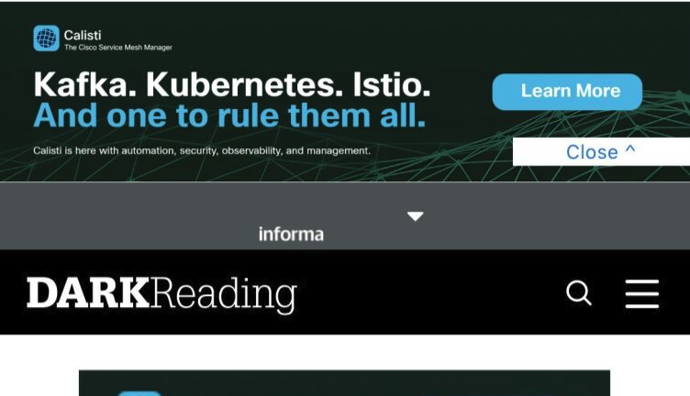
RICH MEDIA ADVERTISING
Enhance your advertising strategy with Rich Media Advertising, designed to make your brand stand out and captivate your audience like never before. With our interactive and visually stunning imagery, you can effortlessly engage users and leave a lasting impression.
Rich Media Advertising allows you to deliver impactful messages directly to your target audience, ensuring your ads resonate with them on a deeper level. By combining captivating visuals and interactive elements, you can create an immersive experience that drives higher user engagement and boosts brand recall.
Product Details
Advertising placements on Informa brand sites
Informa may create or client may create rich media ads
Reporting metrics include clicks, opens, and CTR

Slide 9
DATA MARKETING SOLUTIONS

Slide 10
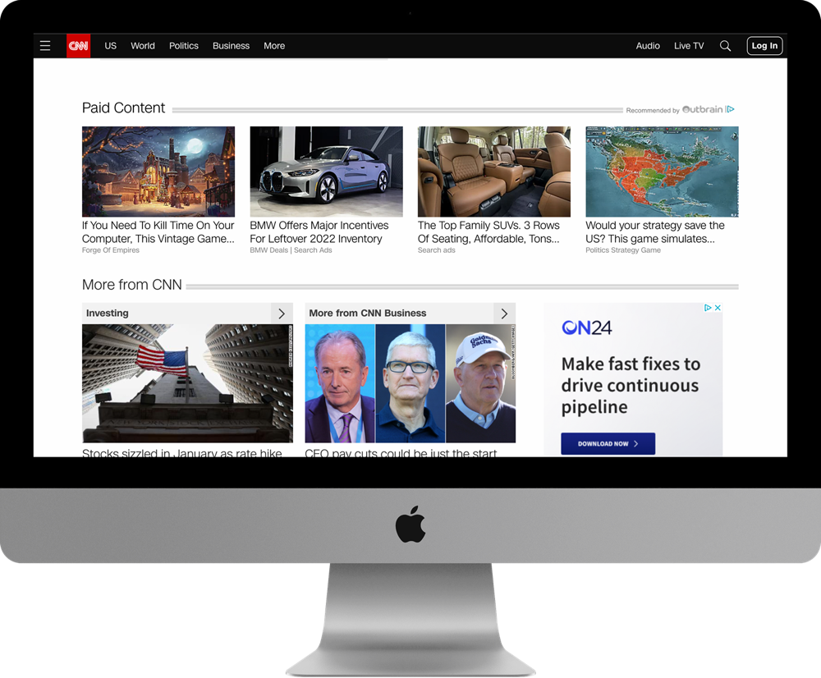
AUDIENCE EXTENSION
Audience Extension campaigns target the business decision makers in our database who match your target criteria. Utilizing thousands of sites across the web, your campaign is displayed multiple times, ONLY to those that fit your audience requirements.
Ensure your ads are viewed on trusted sites that your target audience frequents. Don’t spend another dime advertising where your core audience isn’t. Raise brand awareness and increase engagement with Audience Extension.
Product Details
Audience profiles developed based on Informa first-party data
Target audience segments matched based on demographic, firmographic, geographic, and behavioral data
Ads served across the web on brand-safe websites and social media
Clients increase reach and visibility with the right decision makers

Slide 11
EVENT EXTENSION
Event Extension maximizes the visibility and impact of an event sponsorship by amplifying your marketing message to highly-targeted audiences across the web.
Increase brand awareness by engaging event attendees and prospective customers where they consume online content before, during, and after the event.
By leveraging Informa’s exclusive first-party event data, you’ll gain unparalleled access to decision makers and buyers from across your entire industry.
Product Details
Display banner ads across the web, powered by Informa first-party data
Turnkey event package targeting your top prospects
Pre-determined audience based on event & attendee data

Slide 12
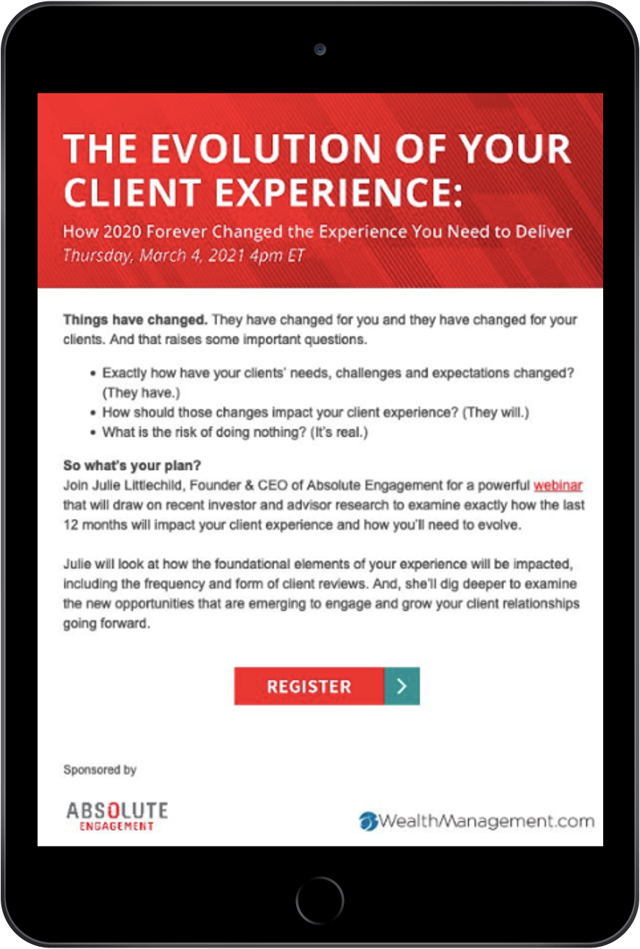
CUSTOM PARNTER EMAIL
Informa Engage is your one stop for creating highly relevant content that engages your audience through beautifully designed custom emails
Keeping your target customer in mind, we deliver helpful information that educates and informs in a co-branded, competitive-free environment. Generate interest and new business for your company by nurturing prospects throughout their journey. Capture engaged prospects with winning emails that share captivating content.
Product Details
Align your message with a credible brand to increase awareness and credibilty
Experienced team works with you to determine targeted distribution list
Single or multi-touch to extend frequency
Drive website traffic and brand awareness to your target audience
Generate engagement for product announcements or press releases
Announce your presence at a tradeshow or conference

Slide 13

CUSTOM POSTAL DIRECT MAIL
The key to any successful marketing initiative is reaching the right audience. Custom Postal Direct Mail from Informa Engage enables marketers, agencies and brokers to target, engage and activate campaigns targeted at B2B decision makers that rely on hundreds of Informa brands.
Elevate your marketing efforts by expanding your audience and reaching target prospects through leveraging valuable data.
Product Details
High levels of targeting enabling advertisers to slice and dice audience data
Target audience based on demographic, firmographic, and geographic data
Beneficial in promoting content, products, and services
Build messaging that focuses on the topics that drive interest and engagement

Slide 14
CONTENT MARKETING SOLUTIONS

Slide 15
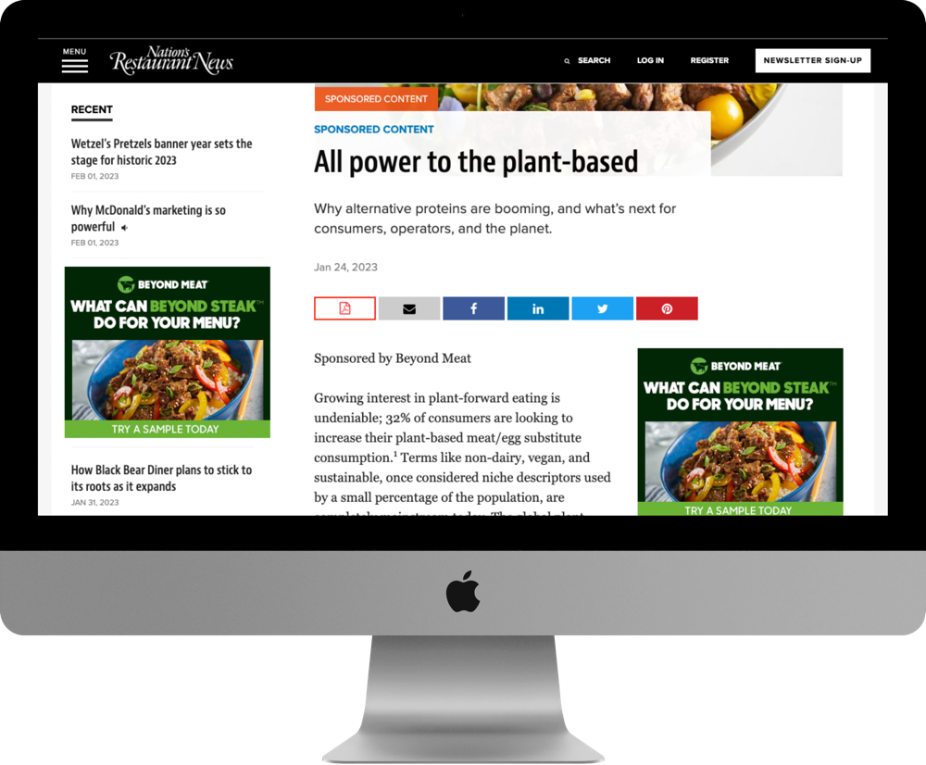
BLOGS & ARTICLES
Provide a clear way for your target audience to move from the awareness to consideration stage. The key to sponsored, native content is high-quality information that is relevant to readers. Our writers are industry experts who ensure success through an effective creative and content development process.
Blogs and articles represent a brand’s credibility, value, and relevance to a specific audience. Engage your target audience through helpful and topic-specific content that resonates long-term.
Product Details
Topic specific blog or article, typically 750 words
Ability to include images, captions, and website link
Ownership of blogs and articles to use across marketing channels
Marketing promotion option available to generate awareness and engagement

Slide 16
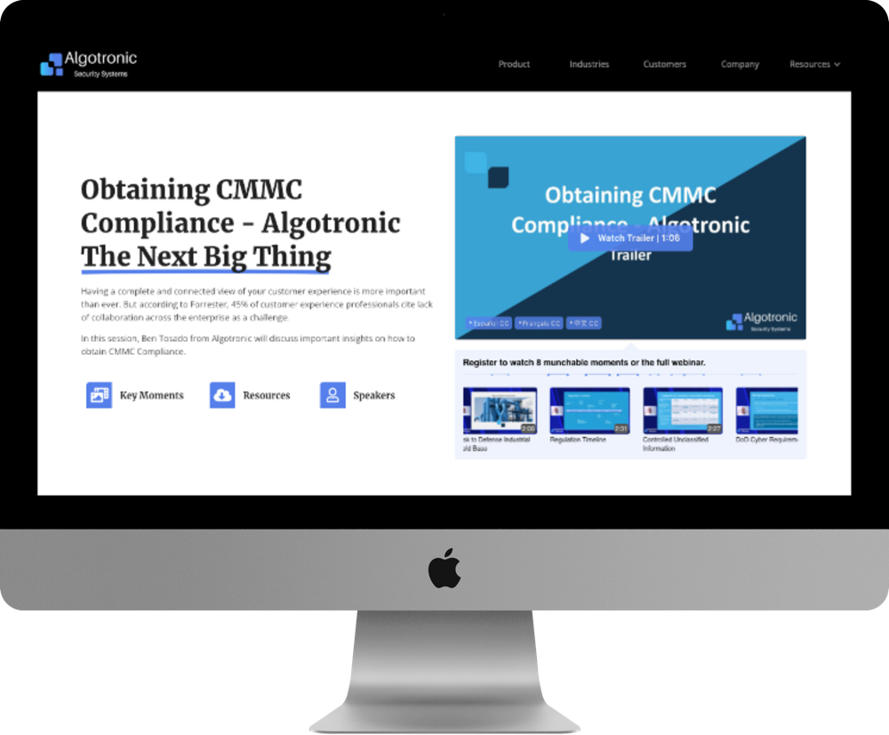
CONTENT MULTIPLIER
Drive more audience engagement and higher quality leads without increasing workload capacity. Content Multiplier amplifies marketing ROI by creating video and content assets that help brands stay top of mind with little to no effort.
AI functionality does the heavy lifting by converting one video asset into over ten powerful content assets from just one webinar, event, or interview video. Content Multiplier enables brands to stay relevant and engaged with their target audience, resulting in higher quality leads over time.
Product Details
Co-branded interactive landing page, highlighting key moments
5 - 10 engaging video moments to focus on the most valuable key points
60 - 90 second video trailer, compilation of key moments
Videos and transcripts can be used for social media, email, and website content
Unlimited usage rights to distribute co-branded Informa videos
Language translation subtitle capabilities
3 related assets can be included on dedicated landing page

Slide 17
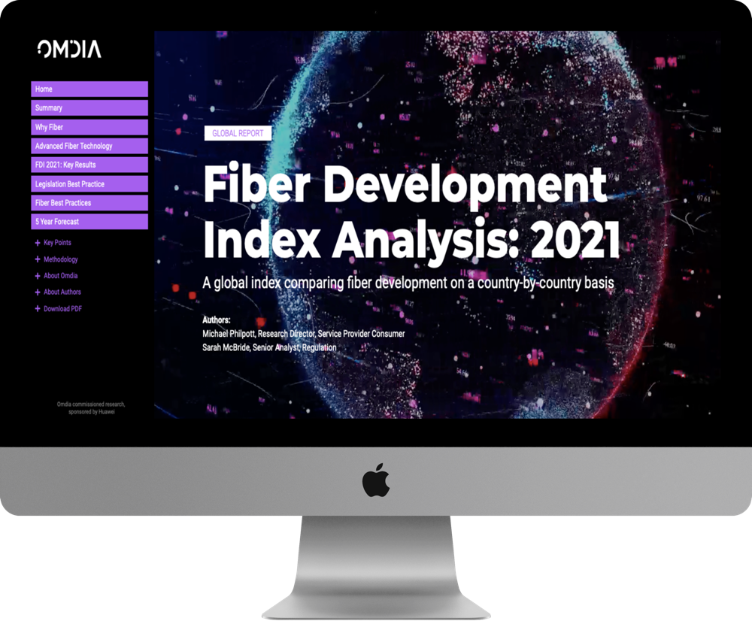
DIGITAL REPORT REPRINT
Drive demand and tell your story with a co-branded digital reprint. Reach your target audience through an engaging, interactive report that elevates your brand through thought leadership. By calling out key sections, your target audience can interact and digest information that’s critical to their decision-making process.
Include call-to-action links to direct readers to your websites and landing pages. Digital report reprints make understanding audience intent simple with analytics and reporting.
Product Details
Standard PDF report converted into interactive digital experience for greater audience interaction and engagement
Up to 8 key content sections featuring specific topical elements
Editorial planning and template design included
Reporting analytics provided

Slide 18
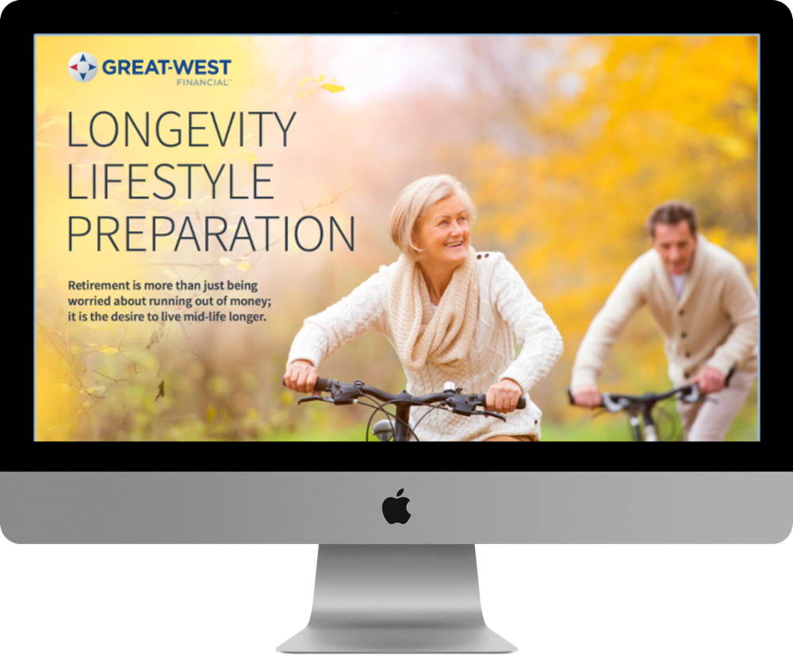
EBOOK
eBooks help solve problems, tackle industry topics or uncover opportunities for your prospects. Compared to white papers, eBooks are typically more visual in nature, have a more conversational tone and often tie related content pieces together into multiple chapters.
Interesting and educational, eBooks are a great way to convey information in an easy to consume, visual format. An effective and influential tool in building subject-matter credibility and generating leads.
Product Details
End-to-end program management including topic discovery, content development, design and production
Standard eBook is 6-page PDF, single-chapter; or also available in multi-chapter series format
Source material can include a mix of news, articles, research, images, graphs/charts, testimonials, infographics, case studies, and more
Marketing promotion option available to generate qualified leads

Slide 19
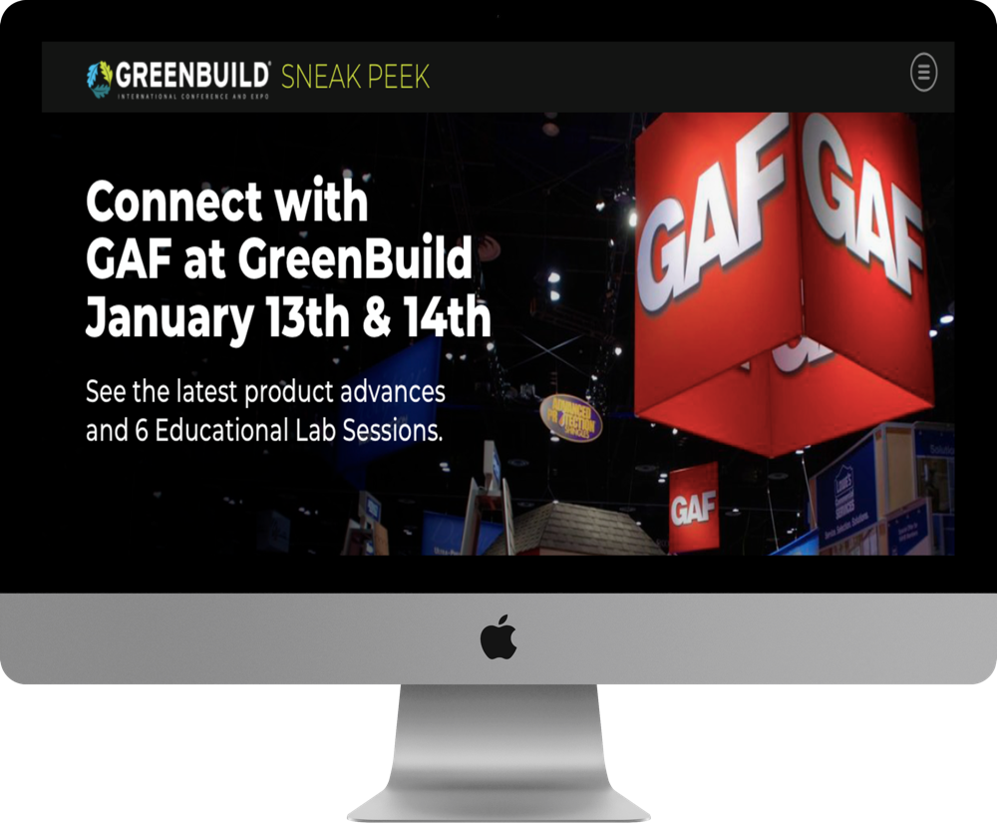
EVENT KICKSTART
Event Kickstart is a co-branded, interactive experience dedicated to a single sponsor. It provides users with a visually engaging, in-depth overview of activities at the show or event.
The Event Kickstart page is perfect for increasing awareness among existing and prospective registrants. Capture the attention of your event attendees with this helpful event overview. If you are looking to drive engagement before, during, and after an event, then an Event Kickstart page may be the solution you have been looking for.
Product Details
Turnkey management including design, development & reporting
Increased brand visibility and ROI of event sponsorship
Showcase products or services in a compelling, interactive experience to warm leads prior to the event
Dedicated sponsor page includes company information, booth location, speaking engagements, and related resources to inform and engage attendees

Slide 20
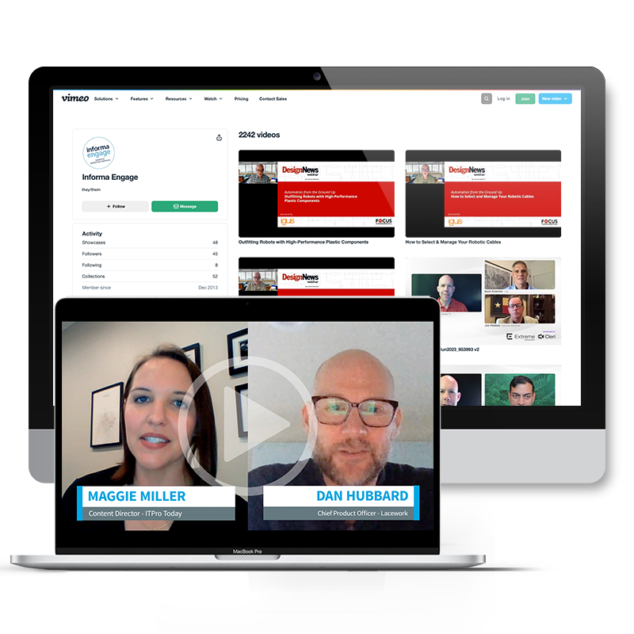
EXECUTIVE QUICKTAKE
Leverage the power of video to make an authentic connection with your audience. ​
This editorially-driven video interview will elevate your expert thought leader by capturing key insights as they discuss current trends, solutions to challenges, announce new products, make a company announcement, talk about upcoming events, etc.
Bridge the live event with an engaging experience to further increase prospect connectivity and interest.
Product Details
Advertising placements on Informa brand websites
Ability to associate marketer messaging with premium, trusted content
Frequency, count, and placements vary based upon each website
Reporting metrics include impressions, clicks, and CTR

Slide 21
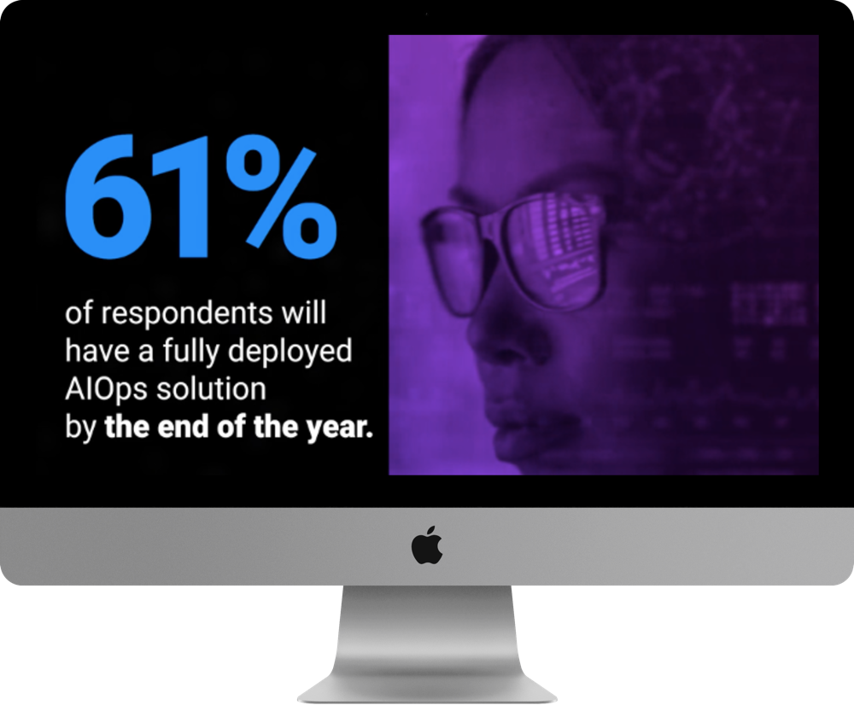
EXPLAINER VIDEO
Explainer Videos break down complex topics into simple and easy-to-digest short video segments. Typically, 30-90 seconds, these videos are perfect content marketing assets that can be leveraged in a variety of ways. They’re especially effective for top-of-funnel prospects in discovery and consideration phases.
With video content on the rise, add explainer videos to your content marketing arsenal and keep your target audience engaged.
Product Details
Creation of one custom, 30-90 second video
End-to-end program management including concept development, storyboards, scripting, production, and editing
Development of animated graphics, imagery, music, and voiceover
Ownership of video for use on websites and social media

Slide 22
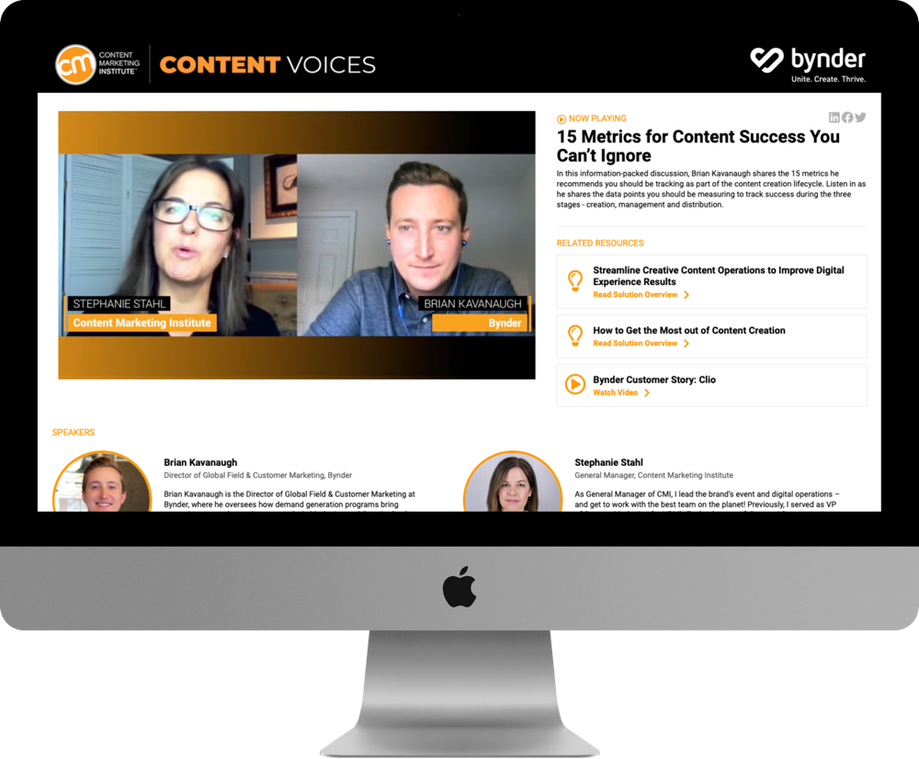
FASTCHAT VIDEO
FastChat video interviews strike a balance between ever-changing customer needs and emerging B2B trends of video-based communication. Interactive by design, video content allows your target audience to build brand preference and loyalty.
The video-based discussions provide a platform for executives and subject matter experts to tell the story of their brand’s innovation, market leadership, and expertise. FastChats create a content marketing experience that generates an authentic connection with audiences hungry for information.
Product Details
Dedicated landing page with up to 3 videos, client logo, call-to-action, and bios
Turnkey marketing promotion
Each video is up to 5-15 minutes length
Remote video capture with interview consists of 3-5 questions
Client may include up to 3 related assets per video on interactive landing page
Turnkey marketing promotion campaign; one month per video
Reporting on user engagement metrics

Slide 23
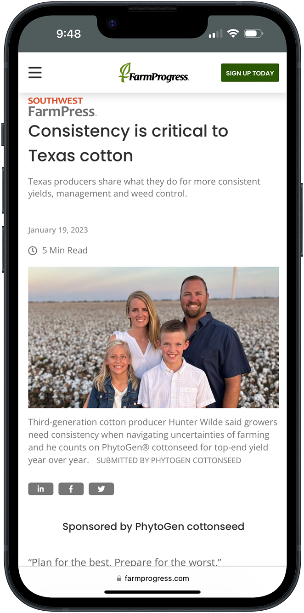
INDUSTRY VOICE
IndustryVoice extends the reach of your educational content by placing it within a relevant category on an Informa brand site. Your brand’s content seamlessly lives next to our brand sites’ credible editorial content in a manner that matches our website’s form and function. This enables readers to have an authentic experience.
Capture your target audience’s attention with relevant and helpful information where they are already searching. Accelerate thought leadership and visibility for your brand with IndustryVoice.
Product Details
Hosted on Informa brand site for 12 months
End-to-end program management including setup, promotion, and reporting
Content is labeled as sponsored
Appears in site’s feeds via relevant category tagging
Promoted via brand newsletters and social networks
Reporting provided after program concludes

Slide 24
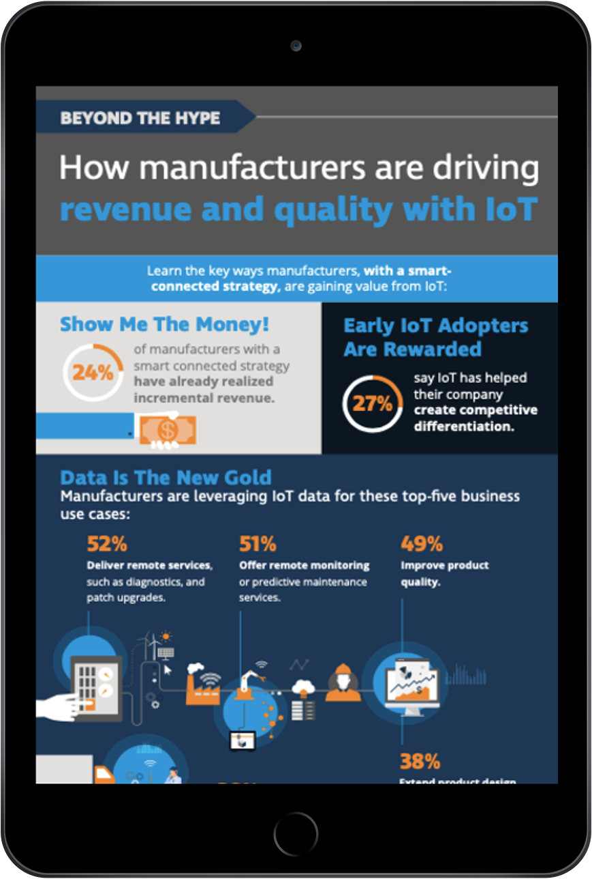
INFOGRAPHICS
Infographics are one of the most shared types of content on the web today, driving more traffic than most traditional content due to their highly visual and easy-to-digest format that helps users translate data into insights.
Infographics draw a wider viewing audience that might otherwise be hidden in long-form content. Visual by design, infographics encourage social sharing, interaction, and engagement. Featuring a clear call-to-action, infographics prompt users with an opportunity to learn more and reach out.
Product Details
Custom design based on relevant, sponsor-provided information
Optimized images for sharing and social search
Option to include marketing and promotion to Informa’s high-value audience
Ownership of asset to use across marketing channels

Slide 25
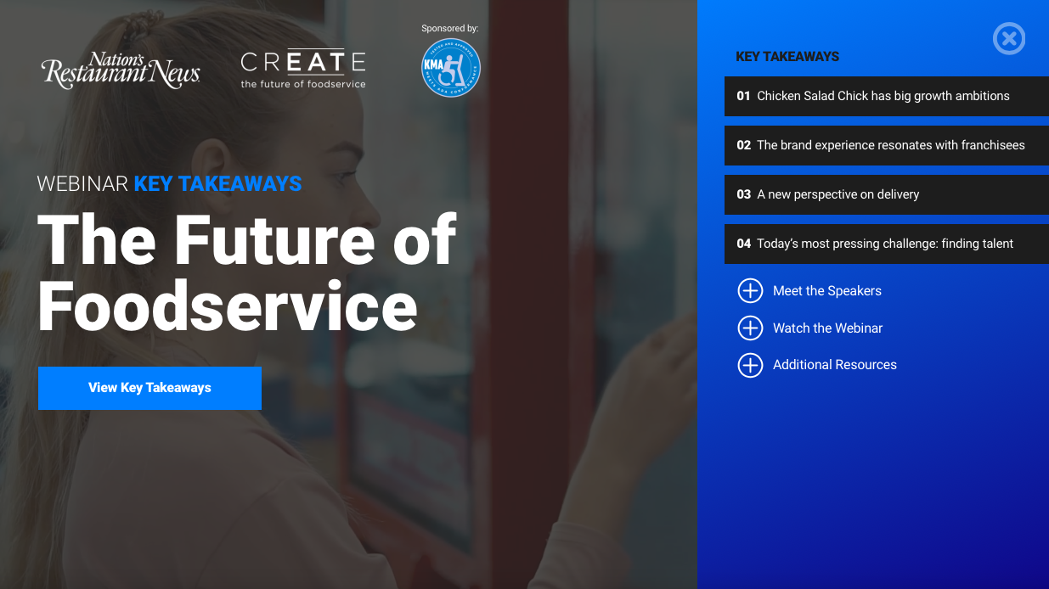
KEY TAKEAWAYS
Key Takeaways capture the central themes from a live webinar, event, research report, or White Paper and breathes new life into the content by framing it through a visual, interactive experience. This not only enhances ROI for marketers by extending the shelf life of their investment, it expands their reach to a broader audience by making the content more accessible.
The multi-media approach benefits buyer personas looking for topline educational material to support their goals but lack the time to diver deeper in the moment.
Product Details
Thought leadership and awareness marketing program to Informa audience
Third-party credibility from aligning with Informa brand
Interactive format captures key points from webinar, research, or live event
Up to 6 key takeaways, serving as an Executive Summary
Short video segments from source material may be integrated
On-ramp to gated asset: webinar, report, or live event
Up to 3 client assets may be included (i.e. white papers, videos, blogs, etc.)

Slide 26
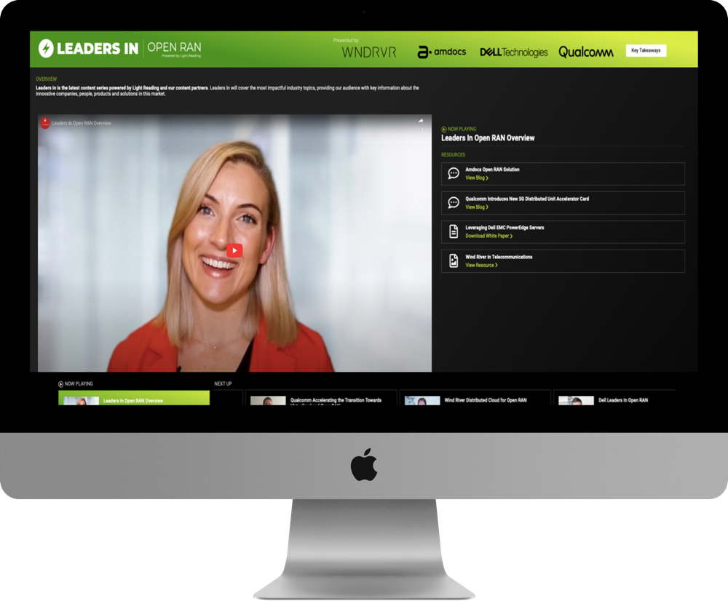
LEADERS-IN
Leaders-In showcases the most transformational products, solutions, and players that are driving innovation around the hottest emerging topics in the industry.
Through video, each sponsor will have an opportunity to showcase a product, solution, case study, thought leadership or executive that is driving innovation and share why their solution is transformational to the market. All content will be showcased in an education, informational and contextual manner to drive interest from Informa’s audience.
Product Details
Interactive destination landing page hosts all video and related assets
One editorial, non-commercial video sets the tone and central theme
Up to 4 sponsors may participate by sharing thought leadership and innovation
Sponsors receive one video (5 – 15 minutes in length) and one interactive landing page to showcase up to three related assets

Slide 27
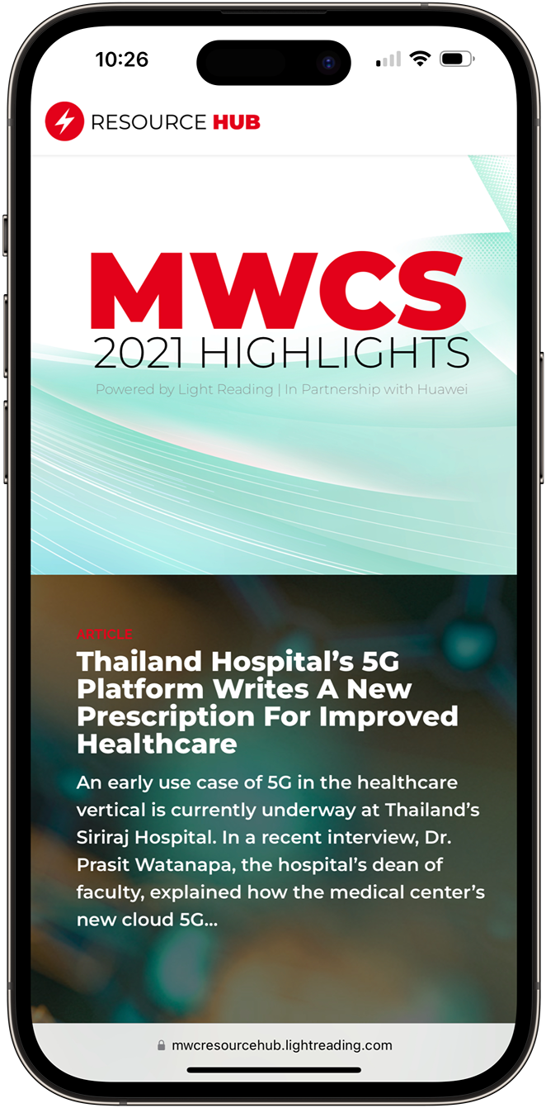
MARKET SPOTLIGHT
Market Spotlight provides industry executives with comprehensive, insightful information on a single issue or trend. Surrounding noise is eliminated with a clean, intuitive design.
Bring a key topic to life with strong imagery and high-value content to engage and educate users. Market Spotlight helps move prospects through the buyer’s journey, leading them to learn about your brand, engage with the content, and ultimately decide on a solution.
Product Details
Bespoke, interactive marketing experiences developed in consultative format
Mobile-friendly, responsive design
Built on a robust, flexible framework that can integrate any content type
Dives deep into one key topic
Promotion plan tailored to objectives
Detailed site reporting

Slide 28

PODCASTS
Podcasts are designed to be consumed by professionals interested in industry trends or company information that can help them do their jobs more efficiently, save their organizations money, or in some other way help improve the business listening to interviews with client contacts.
The topics are typically developed by the clients, who often have a goal in mind. The topic and final delivery are created and executed to align with the initial vision, ensuring feedback from the expert moderator is incorporated.
Product Details
Short 15 to 30-minute webcam or audio podcast
Interview conducted by an industry expert of a client contract, or a solo Informa provided presentation only.
Podcast formats: Interview, solo commentary, or scripted non-fiction storytelling
Podcast episodes and archive can be hosted on Informa brand website and promoted via eNewsletters.

Slide 29

PRODUCT SPOTLIGHT
EVENT GUIDE
The Product Spotlight Event Guide is a valuable way to further engage a captive audience. Showcase your suite of products while you already have the attention of attendees before, during, and after an event.
These interactive event guides create valuable, interactive experiences for attendees, guaranteeing advance exposure opportunities for sponsors that will increase the overall ROI of their investment.
Product Details
Interactive guide housed on a unique URL
CTA on main page that leads to product showcase pages
Product call outs with product description, benefits, and images/video
Reporting metrics include traffic, clicks, CTR, and conversions
Premium sponsorship callouts that share up to 3 assets (i.e. spec sheet, video, brochure, etc.)

Slide 30
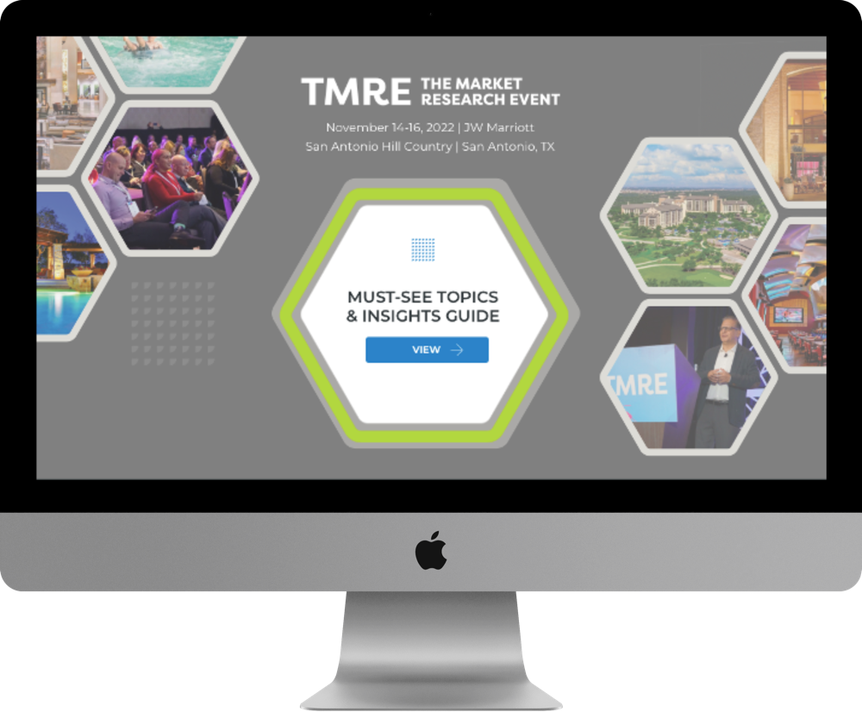

EVENT GUIDE
Capture audience attention and enhance the entire event experience with our event guides. These powerful digital resources are designed to captivate a target audience before, during, and after an event, ensuring a lasting impact that extends beyond the event itself.
Our event guides bridge the live event experience through a digital connection, offering a cohesive and immersive experience. They attract and engage a target audience on a global scale, expanding a brand’s reach and creating valuable connections. By offering valuable resources and interactive features, sponsors can create meaningful engagement opportunities, nurture prospects, and maximize ROI.
Product Details
Interactive guide housed on a unique URL
CTA on main page that leads to event insights, resources, and sponsor profiles
Key event content highlighted throughout (i.e., keynote speakers, event highlights, sessions, etc.)
Reporting metrics include traffic, clicks, CTR, and conversions
Dedicated sponsor page includes company logo, company information, up to 3 related assets, links to social profiles, and CTA

Slide 31
PRE-EVENT GUIDE
Whether in-person or virtual, the competition for attention during an event is fierce. Solving for this challenge requires a strategy beyond the live event to seed anticipation with registered attendees and amplify message awareness to achieve meaningful engagement with prospective customers.
A pre-event guide sponsorship increases the chances of attracting the right prospects by being one of the first to engage the audience in the buildup to the event through an interactive, digital experience.
Product Details
Interactive guide housed on a unique URL
CTA on main page that leads to ”must-see” content
Keynote speaker callouts with speaker bio and CTA
Reporting metrics include traffic, clicks, CTR, and conversions
Dedicated sponsor page includes company logo, company information, up to 3 related assets, and CTA

Slide 32
POST-EVENT GUIDE
The days following an in-person or virtual event are an opportunity for sponsors to continue building momentum and nurturing attendees toward decisions that convert to greater ROI. Post-event guides bridge the live event experience through a digital connection to provide prospective customers with information related to their needs, while further increasing your exposure to a global audience.
Maximize ROI and capitalize on a captive audience by providing a clear path for further engagement. Our digital guides empower attendees to stay engaged by continuing the conversation with your brand.
Product Details
Interactive guide housed on a unique URL
CTA on main page that leads to event highlights, resources, and sponsor profiles
Event summary and recap of event highlights
Reporting metrics include traffic, clicks, CTR, and conversions
Premium sponsorship callouts that share key information, CTAs, links to social profiles, and a resource for continuing the conversation

Slide 33
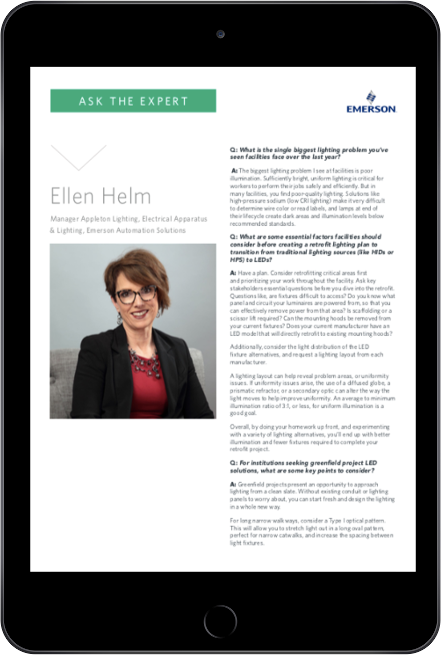
SHORT-FORM CONTENT
By design, short-form content quickly captures your target market’s attention. Leverage Informa’s content experts, creative talent, and marketing expertise to add a powerful advantage to your content marketing campaigns.
Our team of experts develop content assets that resonate with your target audience, providing your brand with unique, custom content that offers long-term marketing value. Capture your audience’s attention with short, digestible content that resonates.
Product Details
Ask the Expert: Showcase the perspective of an executive or product expert
Case Studies: Illustrate solutions to your customer’s pain points
Difference Between: Answering search queries for decision makers
Fact Sheets (aka FAQs): Answer common questions about a particular topic
Sponsored Articles: Informative content developed per your objectives
Top 10 Cards: High-value points that aid in a prospect’s decision making

Slide 34

WEBINAR EXECUTIVE SUMMARY
Engage with your prospects beyond a webinar. The Webinar Executive Summary allows for webinar attendees and prospects who could not attend, to gain insight and understanding around the key topic discussed at the webinar.
This downloadable pdf gives your target audience relevant information to that informs their decision-making process. Generate interest, nurture leads, and drive customer volume with a webinar executive summary.
Product Details
Co-branded Executive Summary developed from webinar content
Topic specific content to support lead nurture and marketing automation
Rights and ownership of content asset
Downloadable and shareable PDF format

Slide 35
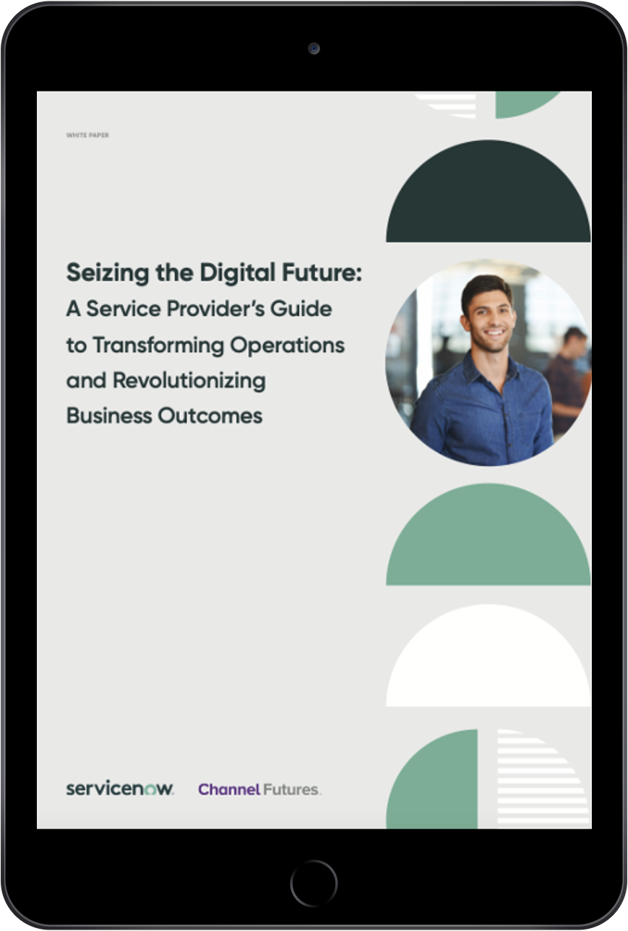
WHITE PAPER
White papers are a great way to provide content that outlines solutions to industry problems, make recommendations for emerging technologies, or expand research on market trends.
Informa-developed white papers help you establish subject-matter expertise and thought leadership, while nurturing leads through the buyer journey. They are also effective at generating high-quality leads when paired with a lead generation program.
Product Details
End-to-end program management including content development and design
Experienced editors or subject-matter experts work closely with you during content creation process to ensure messaging is on target
Ability to include text, images, graphs, links, and sidebar with existing content
Ownership of content assets for use across marketing channels
Marketing promotion option available to generate qualified leads

Slide 36
LEAD SERVICES

Slide 37
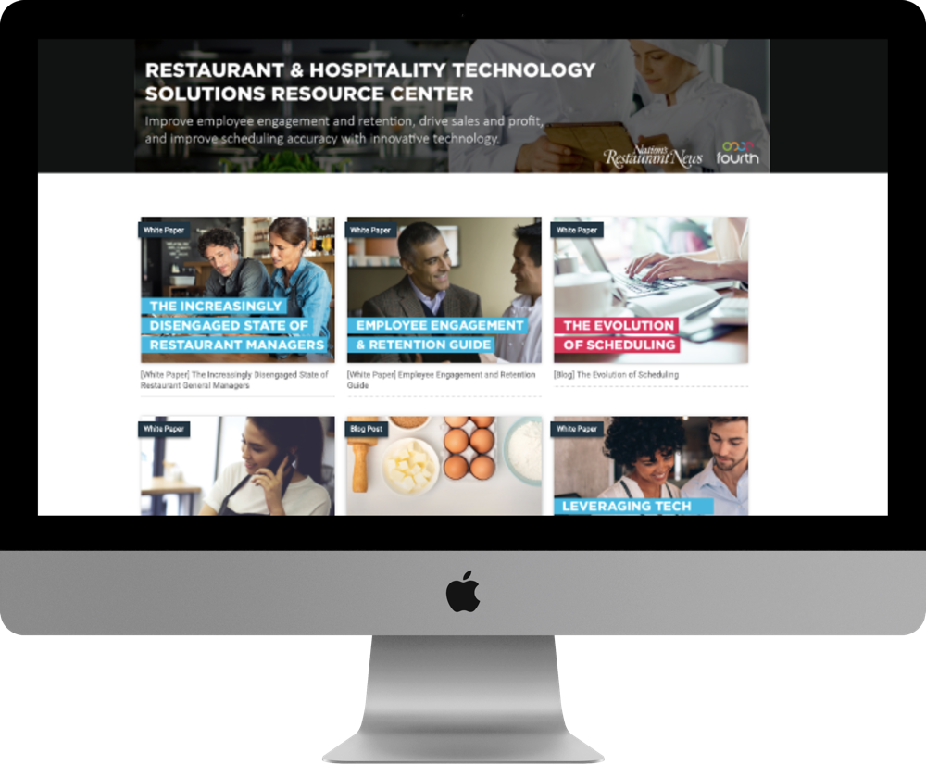
CONTENT ENGAGEMENT CENTER
Package your valuable content marketing assets into a user-friendly digital hub where users can self-educate. Our multi-touch marketing campaign and single-sign-on approach help generate quality leads.
The always-on nurturing allows prospects to choose the time and place in which they engage—leading users to spend more time binging your content. Extensive lead intelligence data is provided, so your sales team can reach out to the warmest leads first.
Product Details
End-to-end project management including setup of a branded environment, creative design of all materials, turnkey promotion, and reporting
One-time site registration to capture leads allows users full access to all content
House up to 9 related assets, including PDFs, videos, images, etc.
Built-in content promoters and sharing tools to encouraging binging activity
Regular lead and engagement reporting throughout the program

Slide 38
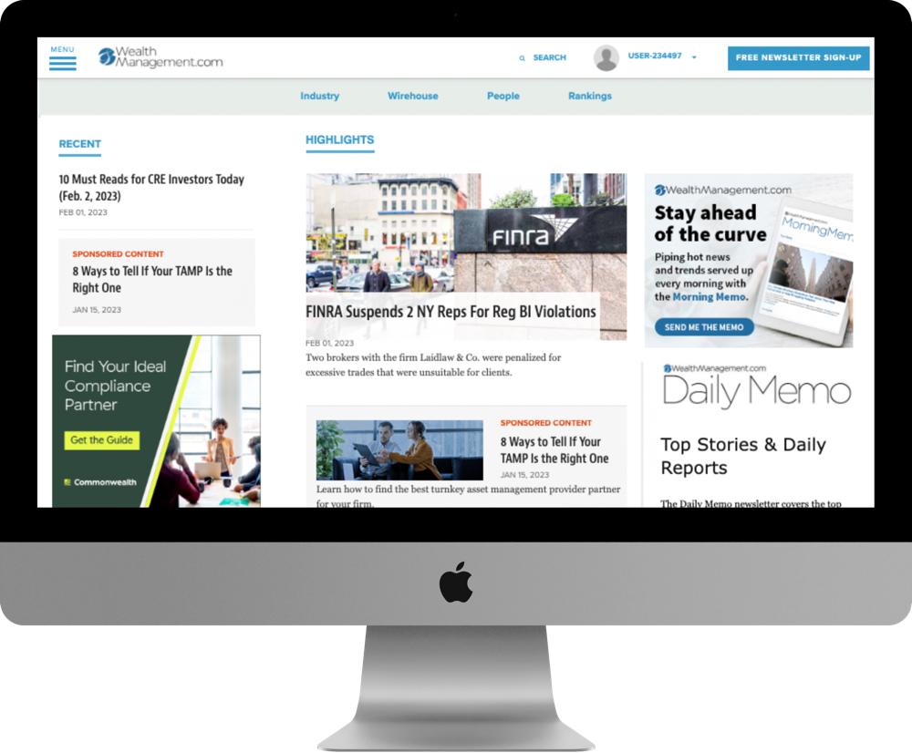
CONTENT SYNDICATION
Drive high quality leads and audience engagement with content syndication. B2B content syndication is a key lead generation ingredient for many companies – large or small.
Reach your target audience by hosting your expert content such as whitepapers, blogs, case studies, articles, and videos on our high-traffic sites. Showcase your brand to an engaged and targeted audience using existing content without a heavy lift. Get in front of your audience and keep them engaged with content syndication.
Product Details
Sponsored content displayed across high-traffic and industry specific sites
Co-branded promotional campaign targets the Informa audience through a multi-channel marketing campaign
Leverage supplied or custom-created content for optimal performance results
Qualified leads are verified for accuracy and quality standards

Slide 39

CONTENT LEAD TOUCH
We map three pieces of your thought leadership content to the needs of your prospects at key buying stages. A series of three emails is sent to 5,000 targeted contacts to generate interest and encourage engagement.
Lead data is given for each user who registers, as well as overall campaign engagement metrics. Engage your target audience and receive lead intelligence data? It’s a straight-forward and data-rich solution for lead generation.
Product Details
Target 5,000 contacts from our database based on available criteria
Up to 3 client-supplied assets to support lead conversion
Three-touch, co-branded email strategy driving to each piece of content
Content housed on a co-branded, interactive landing page
Reporting includes email metrics and contacts engaging with communications

Slide 40

WEBINAR LEAD TOUCH
Gain greater return on your webinar investment by engaging leads immediately after your event to maintain a conversation and move them toward a follow-up action.
Webinar Lead Touch includes the development of an executive summary along with a series of three emails to encourage sharing, drive on-demand views, and expose users to related content. Further qualify and motivate your webinar registrants by staying top of mind.
Product Details
End-to-end program management including content mapping, email development, and email deployment
Co-branded Executive Summary summarizing key highlights from the Webinar
Includes 3 co-branded, follow-up emails to all webinar registrants approximately 2 days, 1 week, and 2 weeks post-webinar
Reporting includes email metrics and contacts engaging with communications

Slide 41
RESEARCH SOLUTIONS

Slide 42
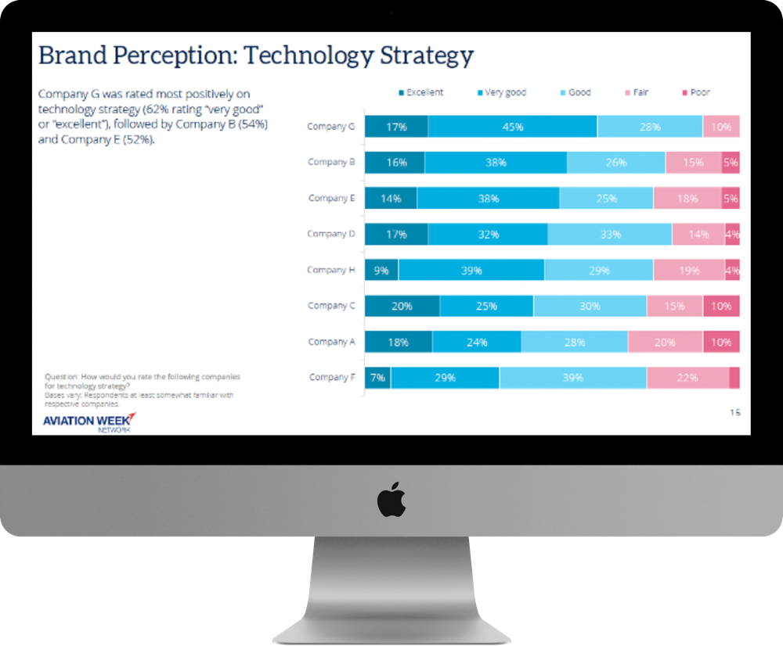
BRAND PERCEPTION
Your customers and prospects matter; and so do their opinions. Our in-depth market research will help you better understand the market perception around your brand, brand recognition, purchase intent, behavior, value, and more.
Provide valuable insight into the positioning of your brand among your competitors, so you can take your marketing strategy to the next level. By conducting a Brand Perception study, you’ll pinpoint areas of strength and opportunity.
Product Details
15-question survey, collaborative creation
100+ respondents from target audience
Graphical summary report provided (10-15 pages)
Full respondent data tables provided
Exclusive + unlimited usage rights

Slide 43
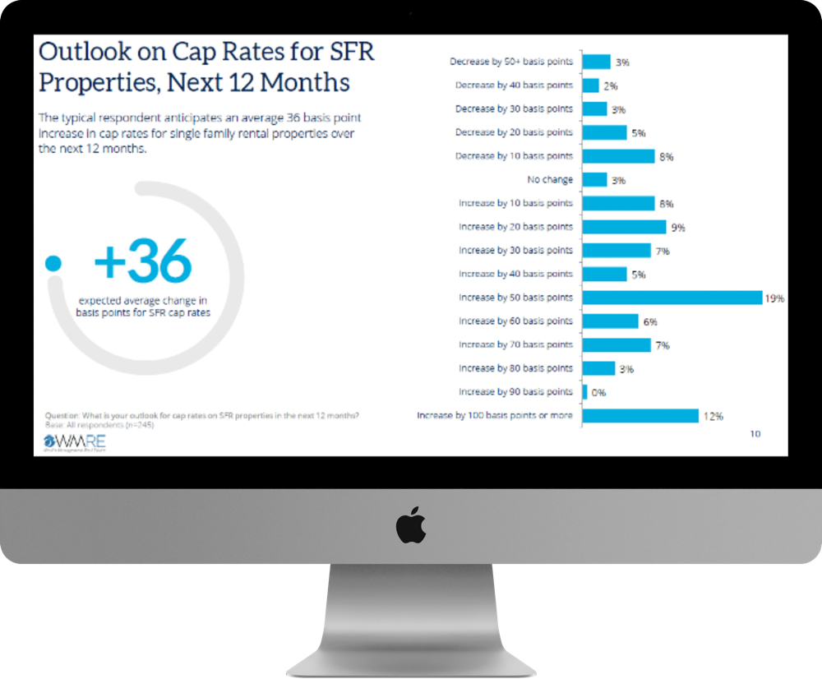
CONTENT KICKSTART
In today’s highly competitive content marketing space, average content is just not cutting it anymore. Users expect content that is objective, visual and high-value, so make it easy for them to access the information the are looking for.
Content Kickstart helps inform on the type of content that will be most effective with prospective customers, while also providing rich data to inject directly into your content marketing assets.
Product Details
15-question survey, collaborative creation
100+ respondents from target audience
Graphical summary report provided (10-15 pages)
Full respondent data tables provided
Exclusive + unlimited usage rights

Slide 44
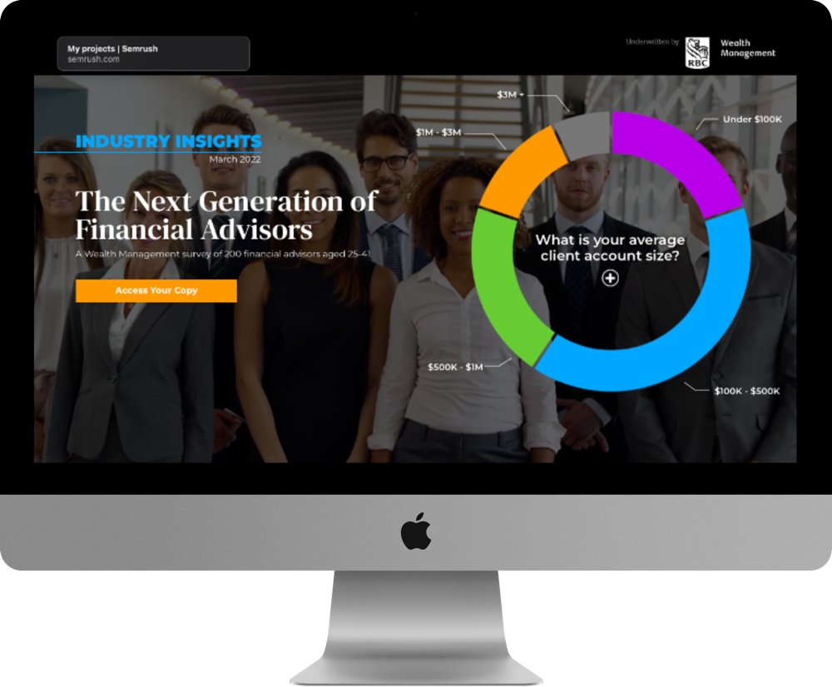
INDUSTRY INSIGHT
Provide your target audience with research-backed data on hot-button issues. Industry Insight studies can measure top pain points, organizational impacts, and future outlooks on a specific topic.
The results are presented in a 10 to 15-page report that provides readers with a clear understanding of the topic and helps them benchmark their position on the topic relative to their peers. Gain strategic insight into your industry while engaging your audience.
Product Details
15-question, editorially-driven survey
100+ respondents from target audience
Co-branded, graphical summary report for market-facing use (10-15 pages)
Turnkey, multi-channel marketing campaign (i.e., email, newsletter, site & social)
Dedicated, interactive landing page featuring report, to capture leads
Qualified leads, delivered over 3 months

Slide 45

MARKET LEADER PROGRAM
Fuel customer demand and prospect engagement with expert-led research and content. The Market Leader Program harnesses the voice of Informa’s influential audience to create an insightful and data-driven content program, designed to educate your buyers on the key trends of your market.
Each stage of this four-part program builds on Informa’s proven framework of awareness and lead generation initiatives to create an immersive, customer-centric experience for true a thought leadership series that delivers a continuous ROI.
Product Details
Informa Research Study, analyst-led market research underwritten by sponsor(s)
Co-branded report developed from survey research and presented in an interactive, digital market-facing experience
Dedicated sponsor section featuring customer-supplied blog post and up to three relevant marketing assets supplied by customer
Moderated roundtable webinar featuring a conversation with sponsor executives to expand upon research data and share related industry insights

Slide 46
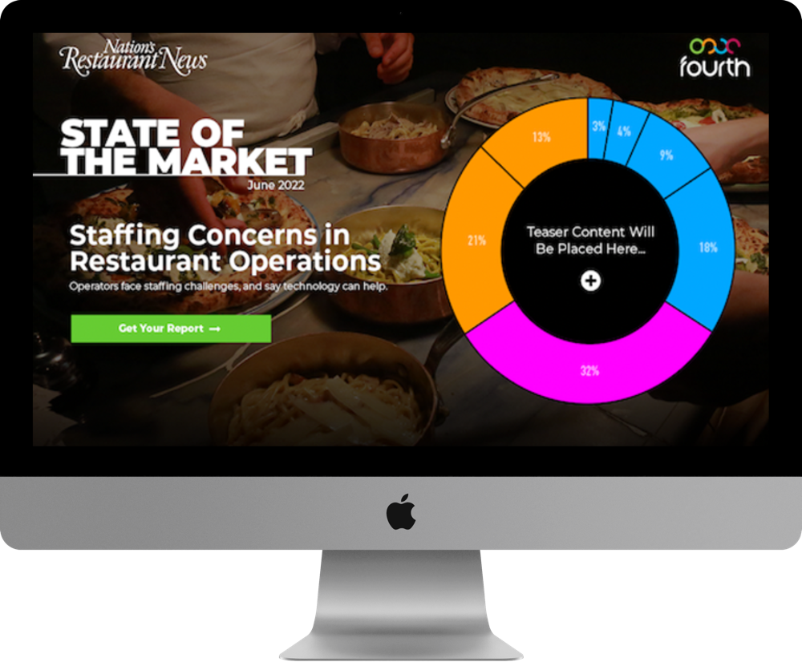
STATE OF THE MARKET
Establish thought leadership and drive quality leads with this market-facing research report. With State of the Market, comprehensive market research is coupled with analysis from a subject-matter expert around an industry hot-button issue.
The resulting report dives deep into the heart of a specific topic to help readers understand the forces at play and gain intelligent insights for smart decision-making. Engage your target audience with this insight-rich report.
Product Details
20-question, editorially-driven survey that includes 2 custom questions
200+ respondents from target audience
Market-facing research report with expert analysis
Turnkey, multi-channel marketing campaign (i.e., email, newsletter, site & social)
Dedicated, interactive landing page featuring report and up to 3 customer assets
Qualified leads, delivered over 3 months
Exclusive sponsorship + unlimited data usage rights

Slide 47
WEBINAR & VIRTUAL EXPERIENCE SOLUTIONS

Slide 48
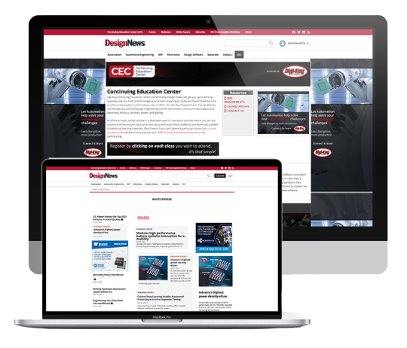
CONTENT GATEWAY
The Content Gateway creates an online content hub for business marketers to curate their digital assets and understand how their customers and prospects engage with that content. House on-demand webinars, videos, white papers, and podcasts in a centralized engagement hub that puts the right content at the fingertips of customers to explore on their own terms.
Every single interaction is tracked and seamlessly integrated into a company’s CRM and marketing automation system providing the behavioral data that marketers need to identify sales-ready leads and accelerate the pipeline. Not only does this ensure your customers and prospects can access your most impactful assets, but it also translates that engagement into data that helps identify your best leads.
Product Details
Drive qualified leads through on-demand resource center
Measure content marketing performance — down to the individual asset
Turn content into an always-on experience
Organize and publish content assets to improve findability and increase engagement
Prioritize and share content based on the level of engagement

Slide 49
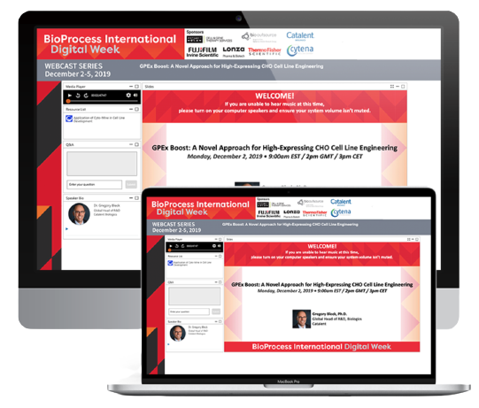
DIGITAL WEEK
Designed to create an immersive experience, Digital Week is an interactive, deep dive into an industry topic led by subject matter experts from industry-leading companies. With Keynote Speakers, Session Leaders, and Q&A sessions, prospects can gain insights into headlining and trending industry news and information in every setting.
The digital platform parades highly interactive features guaranteed to drive prospect engagement and action. A few of the more popular features include gamification capabilities, real-time chat functions, break-out rooms, and resource hubs accessible to all attendees.
Product Details
Extend your reach by showcasing industry-specific, rich content across a webinar series
Generate qualified leads by creating an intuitive webinar experience designed to attract prospects
Increase sponsor ROI by expanding their opportunity to raise brand awareness across a multi-day digital event

Slide 50
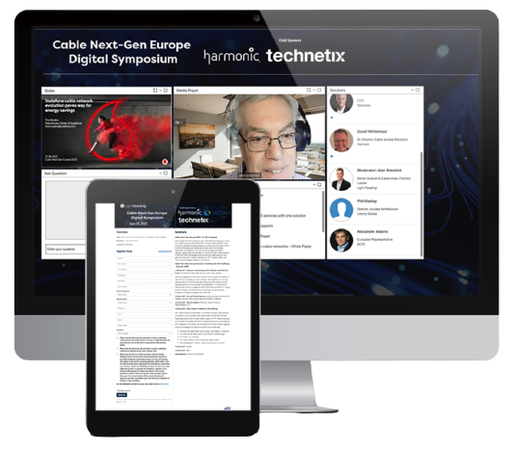
DIGITAL SYMPOSIUM
Digital Symposium cultivates an interactive learning experience for prospects who want a deep dive into industry-specific topics led by industry leaders and subject matter experts.
The digital platform engages prospects through interactive experiences like break-out rooms, gamification, chat functionality, and content resources. Generate qualified leads and intent-driven engagement by hosting a multi-speaker webinar focused on providing key information that drives positive results.
Product Details
Maximize thought leadership with a concentrated focus on a specific topic relevant to your target audience
Accelerate lead generation efforts by cultivating a unique experience strategically designed to engage ideal prospects
Drive tangible value and brand awareness to sponsors

Slide 51
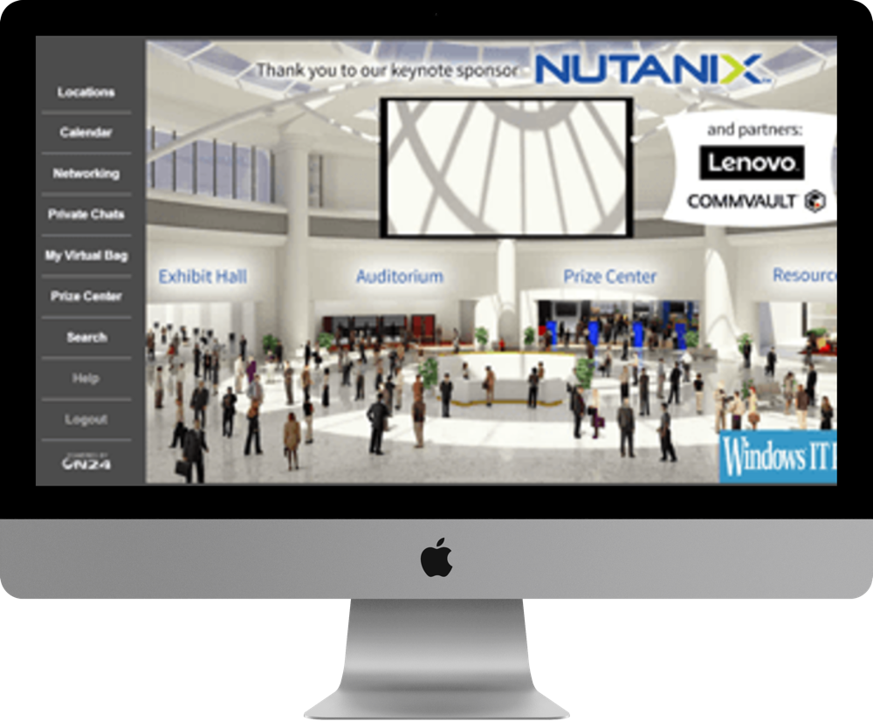
VIRTUAL TRADESHOW
Virtual events bring targeted professionals into an interactive, online environment that provides education through webinars and other thought leadership content and the ability for attendees to interact with products, services or messages from you or your partners.
The interactive platform features various booth templates, real-time chat capability, gamification, break-out rooms, and audio supported video clips that keep your attendees engaged.
Product Details
Conference hall with informational sessions
Exhibit hall with interactive booths
Resource center for audience content
Engage in real-time chat with attendees
Project management, promotions and archive of event included

Slide 52
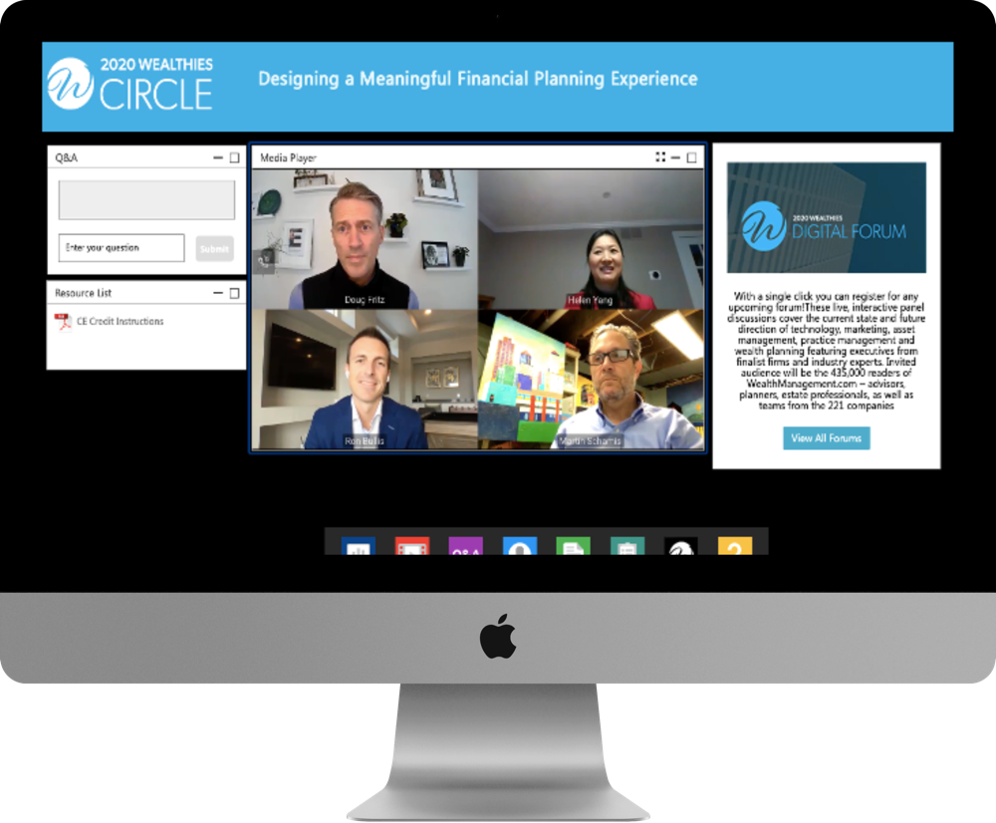
WEBINAR
Position your company as an industry expert by connecting with prospects who are actively looking for education on a key topic or solution to their challenge. Our webinars are a cost-effective way to create powerful, engaging content that generates a high volume of leads and allows you to connect directly with prospects.
With our unique webinar interface, your target audience can interact through networking features, gamification, content environments, breakout rooms, and chat functionality.
Product Details
Up to 1 hour in length, with industry expert moderator and live Q&A
Full-service production of live or pre-recorded event
Presentation may include slides, demos, video clips, and up to 3 poll questions
Turnkey, multi-channel marketing campaign (i.e., email, newsletter, site & social)
Post-event summary includes attendance rate, duration, and engagement
Detailed lead report that includes all registrant contact information

Slide 53
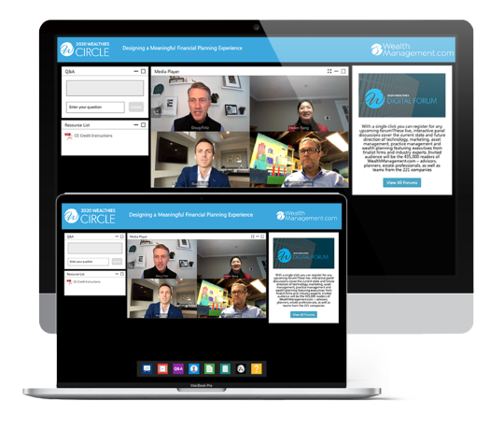
WEBINAR: ANALYST/EDITORIAL
Connect with prospects by positioning your company as an industry expert. By providing an interactive experience, prospects can discover valuable information that can help them make informed decisions. Our webinars are a cost-effective way to create powerful, engaging content that generates a large number of leads and allows you to connect directly with prospects.
With analyst and editorial driven webinars, the virtual experience is rooted in deep subject matter expertise. This provides a unique opportunity to engage with a target audience already interested in the topic at hand.
Product Details
Drive qualified leads through on-demand resource center
Measure content marketing performance — down to the individual asset
Turn content into an always-on experience
Organize and publish content assets to improve findability and increase engagement
Prioritize and share content based on the level of engagement

Slide 54
WEBINAR: SPONSORED
Webinars are an excellent way to nurture prospects further along the sales funnel, educating audiences about solutions to their pain points while helping business decision makers stay informed with insights to make efficient decisions. Marketers can position their company as an industry expert and connect with prospects who are actively looking for education on a key topic, or solution to their challenge.
A sponsor-driven webinar allows the client to dictate the topic and retain control over the presentation. In almost all cases, the client will provide the title, abstract, presenter information, and presentation materials.
Product Details
Drive qualified leads through on-demand resource center
Drive ROI for sponsors by creating unique opportunities to showcase their brand
Measure content marketing performance — down to the individual asset
Turn content into an always-on experience
Organize and publish content assets to improve findability and increase engagement
Prioritize and share content based on the level of engagement

Slide 55
ACCOUNT-BASED MARKETING CAPABILITIES

Slide 56

ACCOUNT-BASED MARKETING TARGETED MEDIA
Provides marketers unprecedented access to the companies and decision makers that matter most. Target only the companies, and the individuals within those companies, that matter most for brand objectives.
A marketing strategy to build stronger relationships with valuable customers and prospects through highly targeted interactions.
Product Details
Client provides pre-determined list of high-value companies
Audience profiles identified and developed to meet target criteria
Targeting powered by Informa’s exclusive first-party database and third-party look-a-like pools to achieve scale
Target data segments are activated to reach and influence buyers across the web through multiple channels (i.e., display, video, native)

Slide 57

ACCOUNT-BASED MARKETING LEAD GENERATION
Marketers provide a list of target accounts for lead generation, audience criteria, and content marketing assets. Campaign parameters are then evaluated against our first-party database and online audience to deliver the most relevant leads according to the marketing objectives.
Lead generation efforts focus on the accounts with the greatest potential for the marketer.
Details
Client provides pre-determined list of high-value companies
Audience profiles identified and developed to meet target criteria
Targeting powered by Informa’s exclusive first-party database and third-party look-a-like pools to achieve scale
Leads are secured from target account list to pinpoint high-value prospects

